Slide 1
Artificial Intelligence:
Some Thoughts?
Stuart Russell
UC Berkeley
Notes:
Reminiscing and pontificating – two of the most enjoyable activities one can do as an academic

Slide 2
Outline
What is AI?
How do we do it?
What if we succeed?
What is AI?

Slide 3
What is AI?
AI = making intelligent machines
Standard model: machines are intelligent to the extent that their actions can be expected to achieve their objectives
The goal is general-purpose AI: capable of quickly learning high-quality behavior in “any” task environment

Slide 4
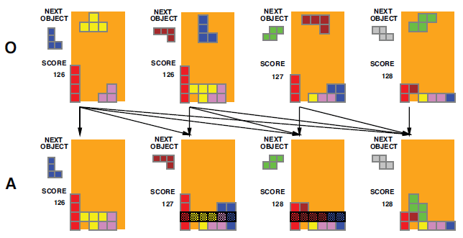
Agent functions
[IJCAI 95 C&T]
Agents perceive O and act A in environment E
An agent function f : O∗ → A specifies an act for any percept sequence
Global measure V(f,E) evaluates f in E

Slide 5
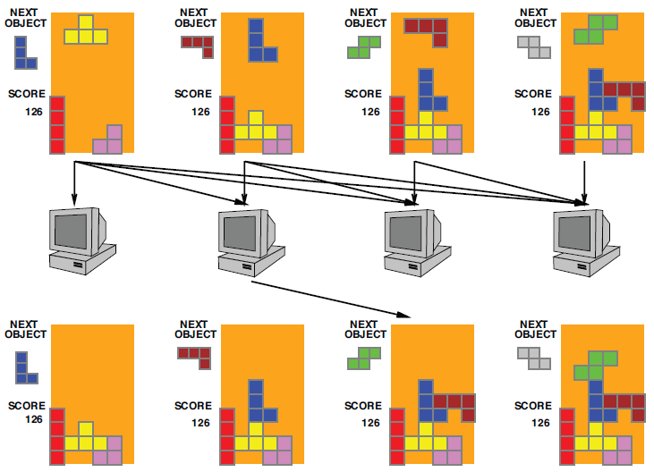
Machines and programs
[IJCAI 95 C&T]
Agent is a machine M running a program l εL_{M}
This defines an agent function f = Agent(l,M)
Feasible(M) = {f: ∃l εL_{M} f = Agent(l,M)}

Slide 6

Bounded optimality
[IJCAI 95 C&T]
Agent(l_{opt},M) is bounded-optimal iff
l_{opt} = argmax_{l}V(Agent(l,M),E)
i.e., the best program given M.
  Interesting? Yes, I’d like one of those
  True? Yes, exists by definition! May be hard to find
  Research? Towards a theory of agent architectures
Bounded optimality is a reasonable substitute for the informal notion of intelligence in the definition of AI

Slide 7

Rational metareasoning
[IJCAI 95 C&T]
Do the Right Thinking:
  Computations are actions
  Cost=time Benefit=better decisions
  Value ≈ benefit minus cost
General agent program:
  Repeat until no computation has positive value:
    Do the best computation
  Do the current best action
Myopic approximation fairly effective in practice
  10-100 times more efficient than alpha-beta (Russell & Wefald, 1989,1991)

Slide 8

[IJCAI 95 C&T]

Slide 9
What’s inside the box?
The essence of the classical AI hypothesis:
There is knowledge inside the box
Learned from observation (or communication)
Supports reasoning and deliberation over futures
  Compilable into more efficient policies
Contributes to further learning
Data
Learning
Knowledge
Knowledge
Formal version: bounded-optimal knowledge-based architectures
dominate simpler agent architectures
Notes:
LIGO examples

Slide 10
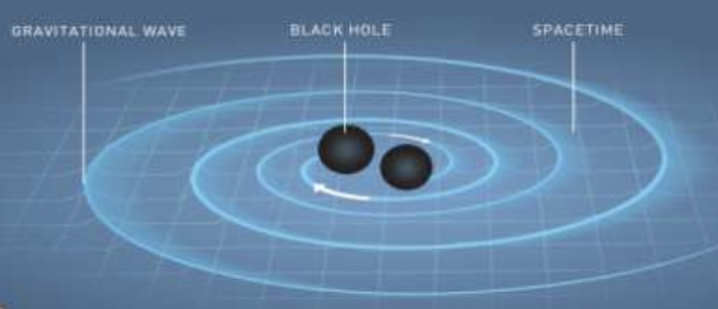
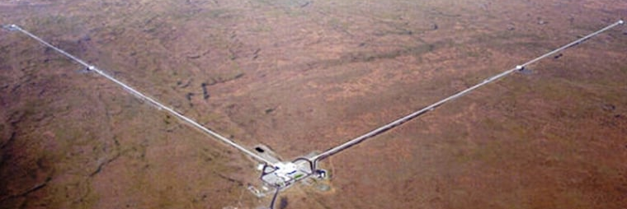
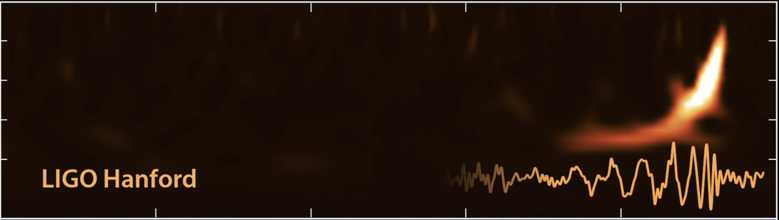
Example

Slide 11
General approach to AI….
Design an agent from components we know how to build
Ask where it breaks
Fix it

Slide 12
Where does it break?
[COLT/UAI/ICML 98]
Problems with classical [GOFAI] agent designs:
Uncertainty
Partial observability
Unknown environment
Slow learning
Notes:
Can we design an agent that we can put down in an unknown environment and have it learn to behave well?

Slide 13
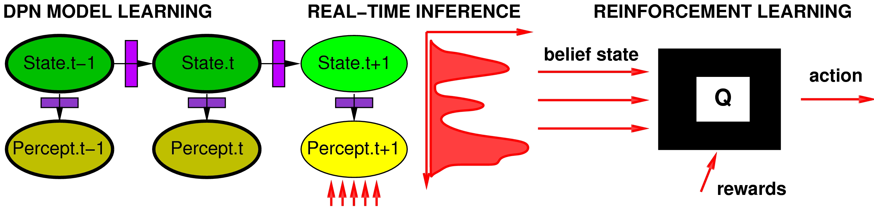
Simple baseline
[COLT/UAI/ICML 98]
Plus inverse reinforcement learning to learn quickly by observing experts

Slide 14
Where does it break?
[COLT/UAI/ICML 98]
“Scaling up the environment will inevitably overtax the resources of the baseline architecture.
There are several directions for improvement, including …
first-order [probabilistic] models
hierarchical representations of behaviour
model-based lookahead methods.”

Slide 15
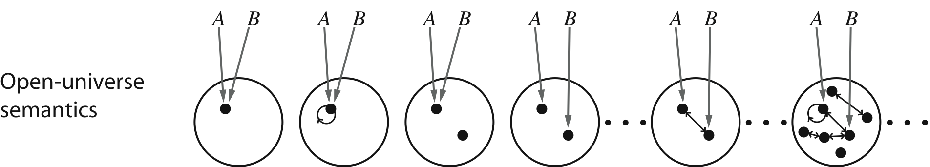
First-order, open-universe models
Combine expressive power of first-order logic with probability theory
Handle existence and identity uncertainty: open universe
objects may exist that are not named in the language
distinct terms may or may not co-refer
=> Unbounded number of very heterogeneous possible worlds
Bayesian logic (BLOG) allows concise definition of open-universe models
and provides a general* inference algorithm

Slide 16
NETVISA: global nuclear monitoring
#SeismicEvents ~ Poisson[T*λ_{e}];
Time(e) ~ Uniform(0,T)
IsEarthQuake(e) ~ Bernoulli(.999);
Location(e) ~ if IsEarthQuake(e) then SpatialPrior() else UniformEarthDistribution();
Depth(e) ~ if IsEarthQuake(e) then Uniform[0,700] else 0;
Magnitude(e) ~ Exponential(log(10));
IsDetected(e,p,s) ~ Logistic[weights(s,p)](Magnitude(e), Depth(e), Distance(e,s));
#Detections(site = s) ~ Poisson[T*λ_{f}(s)];
#Detections(event=e, phase=p, station=s) = if IsDetected(e,p,s) then 1 else 0;
OnsetTime(a,s) ~ if (event(a) = null) then Uniform[0,T] else
Time(event(a)) + GeoTravelTime(Distance(event(a),s),Depth(event(a)),phase(a)) + Laplace(μ_{t}(s), σ_{t}(s))
Amplitude(a,s) ~ If (event(a) = null) then NoiseAmplitudeDistribution(s)
else AmplitudeModel(Magnitude(event(a)), Distance(event(a),s),Depth(event(a)),phase(a))
Azimuth(a,s) ~ If (event(a) = null) then Uniform(0, 360)
else GeoAzimuth(Location(event(a)),Depth(event(a)),phase(a),Site(s)) + Laplace(0,σ_{a}(s))
Slowness(a,s) ~ If (event(a) = null) then Uniform(0,20)
else GeoSlowness(Location(event(a)),Depth(event(a)),phase(a),Site(s)) + Laplace(0,σ_{a}(s))
ObservedPhase(a,s) ~ CategoricalPhaseModel(phase(a))

Slide 17
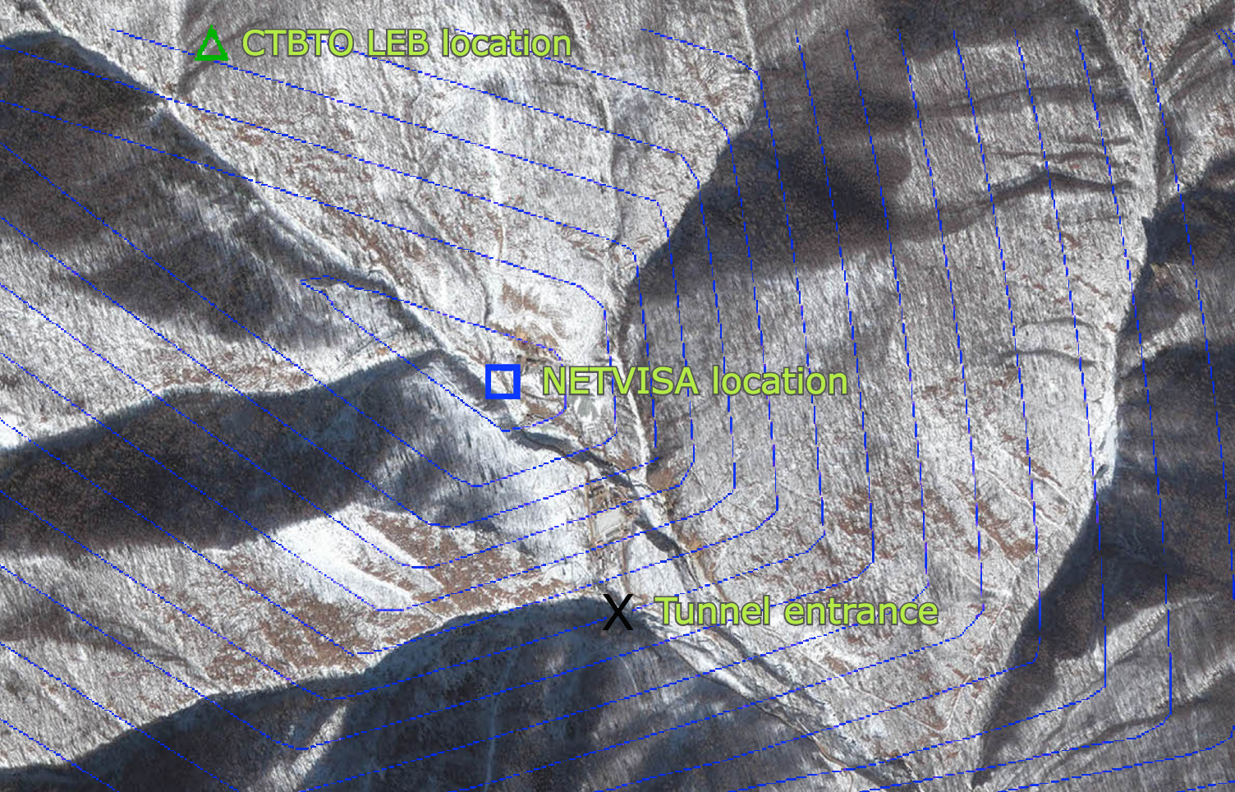
North Korea, Feb 12, 2013
Notes:
Using a different technology, probabilistic programming, my lab’s system NETVISA has dramatically improved the detection and localization of nuclear explosions for the Comprehensive Nuclear-Test-Ban Treaty.
This is a satellite image of the North Korean test site and a test from 2013

Slide 18
Real-time video tracking [Model: UAI97]
…
Intensity(x,y,t) ~
MultivarGaussian(Mean(PixelState(x,y,t),x,y),
Variance(PixelState(x,y,t),x,y));
PixelState(x,y,t) ~
Categorical(MixtureWeights(x,y,t));
…

Slide 19
Real-time video tracking
…
Intensity(x,y,t) ~
MultivarGaussian(Mean(PixelState(x,y,t),x,y),
Variance(PixelState(x,y,t),x,y));
PixelState(x,y,t) ~
if t==0 then Categorical(MixtureWeights(x,y,0))
else TransitionModel(x,y,PixelState(x,y,t-1));
…

Slide 20

Bake-off: OpenCV vs BLOG (real-time)
OpenCV (hand-coded state-of-the-art)
BLOG model

Slide 21
Life: Play and Win in 20 Trillion Moves
(Non-starter: flat RL in the unknown POMDP of life)
Hierarchical structuring of behavior is essential
Markovian temporal abstraction (HAMs, NeurIPS 98):
hierarchical RL
additive decomposition of value across subroutines
parallel activities
  Partial programming languages (Alisp, NeurIPS 00):
  Turing-equivalent formalism for structuring behavior
  Angelic semantics for high-level actions (ICAPS 07,08):
  sound and complete abstract planning
  model-based hierarchical lookahead

Slide 22
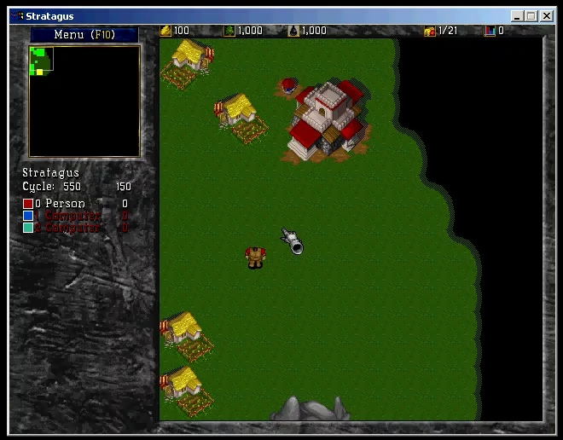

Slide 23
Where does it break?
We lack good ideas for effective discovery of new internal representations (predicates, functions, etc.) in PPLs
We don’t really understand how to create new abstract actions to support hierarchical decision making
(This is a normal state of affairs as science progresses)
The neo-classical AI community needs to be less faint-hearted about engineering effort and computation
(after all, AlphaZero used 10¹⁵ times more computation than Samuel’s checker player)

Slide 24
Deep learning
Doesn’t deep learning solve everything?
DL circuits: wide (like linear regression) and deep (like decision trees)
Linear-time circuits lack expressive power:
  => Very large function representations (exponential for NP-hard cases)
  => No savings in computation, massive increase in sample complexity
  (In principle, a sufficiently large neural TM could invent Python and then learn everything in Python.)

Slide 25
Carter, Jain, Mueller, Gifford (2020, arXiv)
Overinterpretation reveals image classification model pathologies
Notes:
Here’s one problem: recognizing objects without looking at them
Here in the top left is a photo of a parachute
The algorithm (Google’s Inception v3) predicts “parachute” based only on a few sky pixels
The algorithms may not be seeing at all

Slide 26
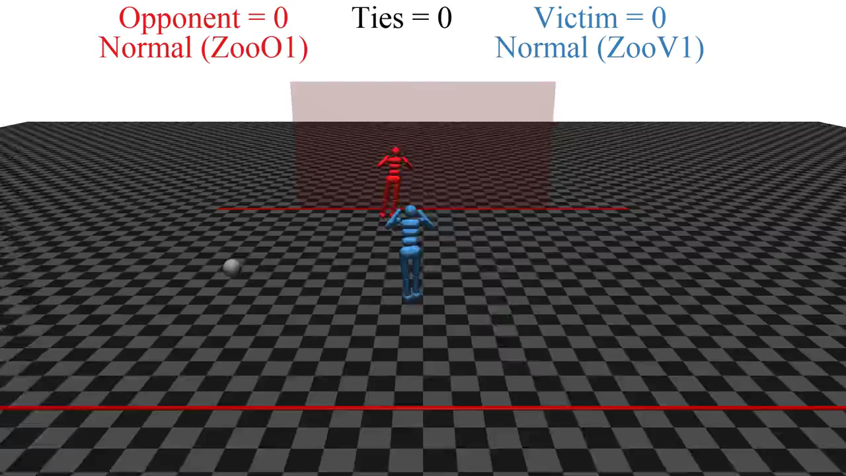

Slide 27
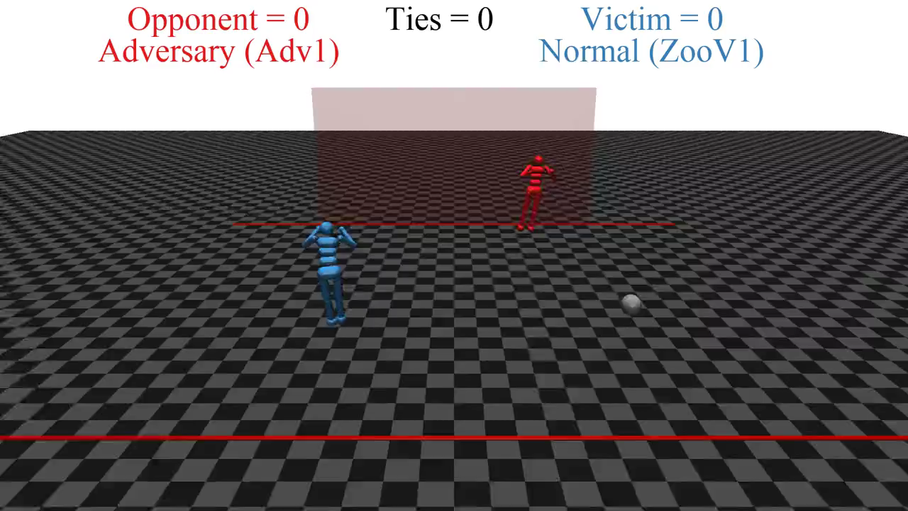

Slide 28
What if we succeed?
Lift the living standards of everyone on Earth to a respectable level
  => 10x increase in world GDP ($13.5Q net present value)
Potential advances in health, education, science
Notes:
Q=quadrillion

Slide 29
It seems probable that once the machine thinking method had started, it would not take long to outstrip our feeble powers. … At some stage therefore we should have to expect the machines to take control
Notes:
This is Alan Turing, founder of computer science, giving a lecture in 1951:

Slide 30
Imminent?
Achieving general-purpose AI still requires multiple breakthroughs
Date unpredictable

Slide 31
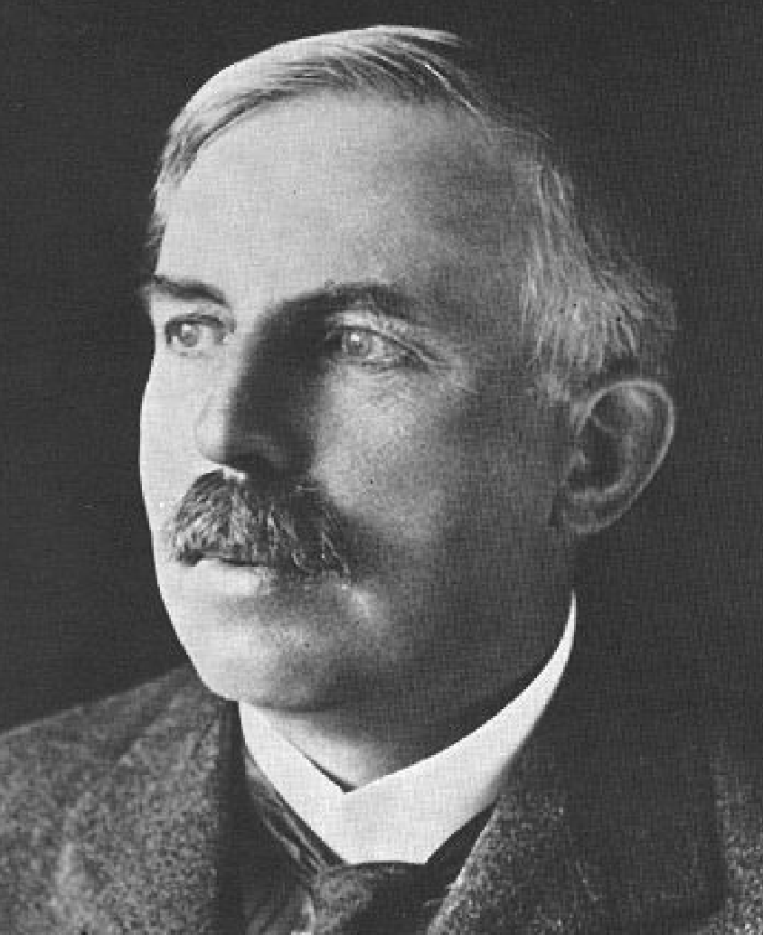
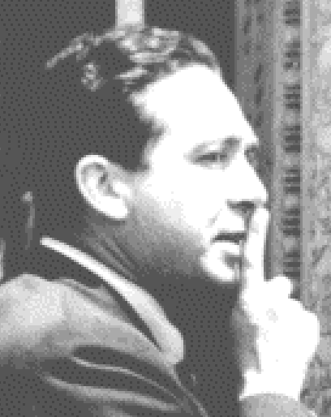
Sept 11, 1933: Lord Rutherford addressed BAAS: “Anyone who looks for a source of power in the transformation of the atoms is talking moonshine.”
Sept 12, 1933: Leo Szilard invented the neutron-induced nuclear chain reaction
Notes:
But, remember that in the case of nuclear energy and nuclear weapons,
it went from categorical denial to “problem essentially solved” in 16 hours

Slide 32
Eventually (but not very soon)…
  AI systems will make better real-world decisions than humans
  Turing’s point: how do we retain power over entities more powerful than us, for ever?

Slide 33
Example: Social media
  Objective: maximize clickthrough
  = learning what people want
  = modifying people to be more predictable

Slide 34
  With incompletely or incorrectly defined objectives, better AI => worse outcomes

Slide 35
A new model
Machines are intelligent to the extent that their actions can be expected to achieve their objectives
Machines are beneficial to the extent that their actions can be expected to achieve our objectives

Slide 36
Provably Beneficial AI
1. Robot goal: satisfy human preferences*
2. Robot is uncertain about human preferences
3. Human behavior provides evidence of preferences
The robot solves a formally defined assistance game
Optimal solutions:
defer to human, ask permission, allow self to be switched off
It is rational for humans to build machines that solve assistance games
Better AI => better outcomes

Slide 37
Extending the basic theory
  Many humans
  => connections to moral philosophy, economics
  Many machines
  => avoiding unanticipated strategic interactions
  Non-rational humans
  => connections to cognitive psychology, neuroscience
  Foundations
  => rebuild each area of AI (search, planning, RL, etc.)
  Application prototypes
  => self-driving cars, digital assistants, personal robots, social media
  Templates and regulations applied to well-founded designs

Slide 38
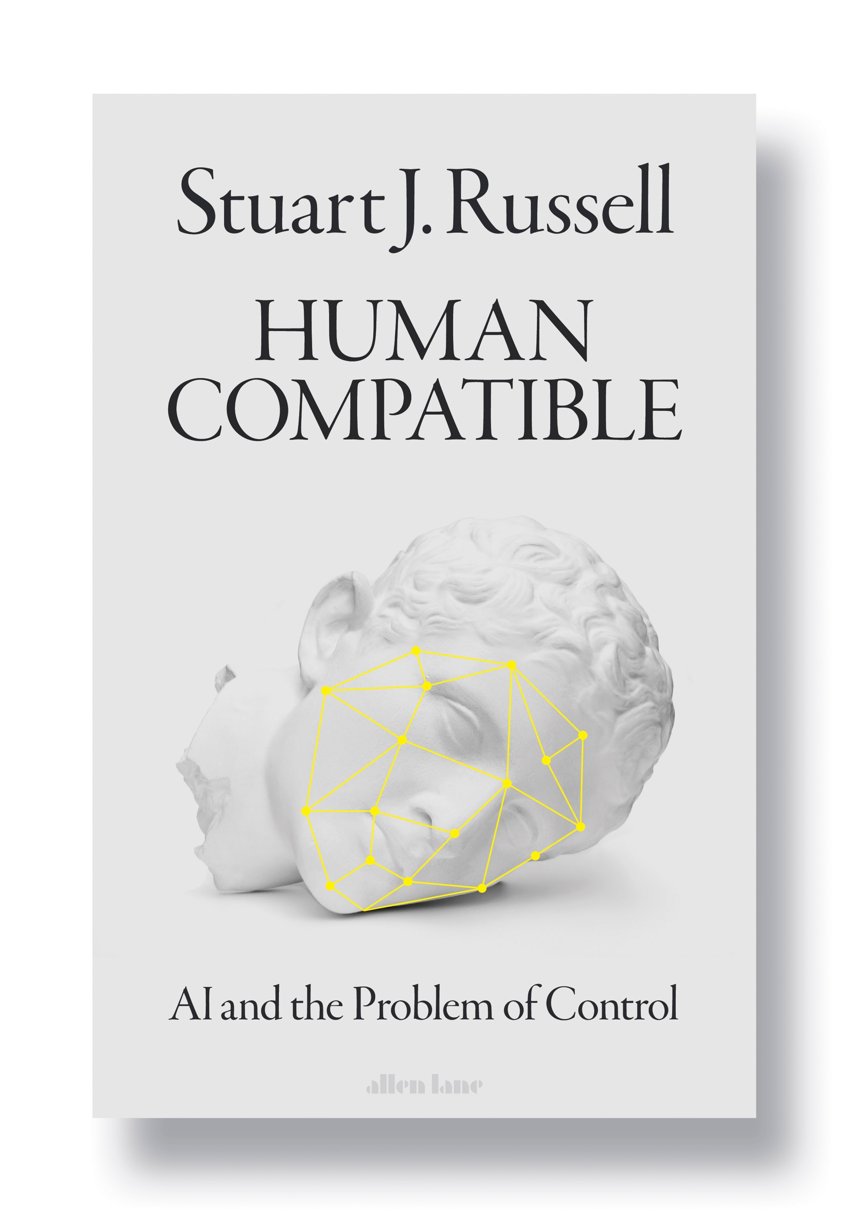
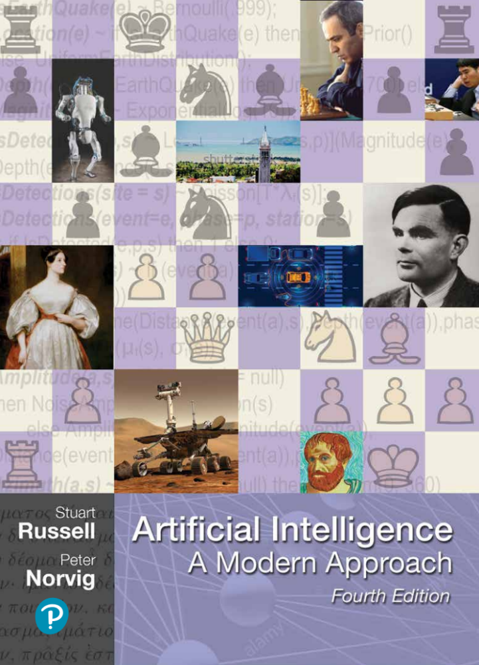

Slide 39

Notes:
Perhaps, eventually, human enfeeblement when we
hand over the running of our civilization to machines, as shown in Wall-E

Slide 40
Summary
Neo-classical AI, supported by deep learning, is a way forward
AI has vast potential and unstoppable momentum
The standard model for AI leads to loss of human control over increasingly intelligent AI systems
Provably beneficial AI is possible and desirable
It’s not AI Ethics, it’s AI

Slide 41
Thanks
To the organizers and hosts of IJCAI 22
To the IJCAI Awards Committee
To my advisors, inspirers, and funders
To all my students and collaborators

