Slide 1
How Not to Destroy the World With AI
Stuart Russell
University of California, Berkeley

Slide 2
It seems probable that once the machine thinking method had started, it would not take long to outstrip our feeble powers. … At some stage therefore we should have to expect the machines to take control

Slide 4
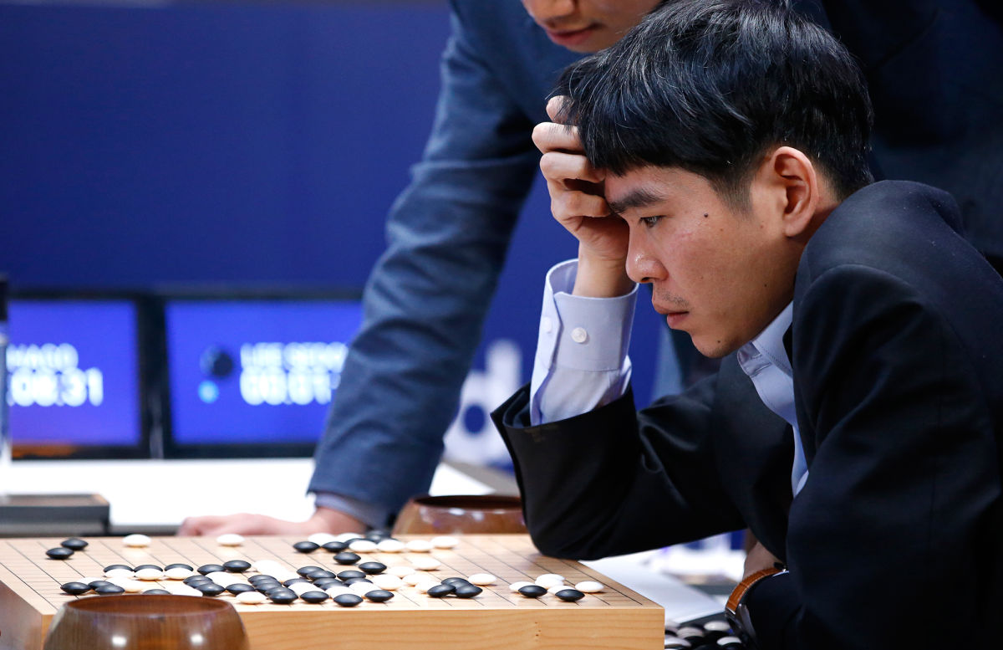

Slide 5
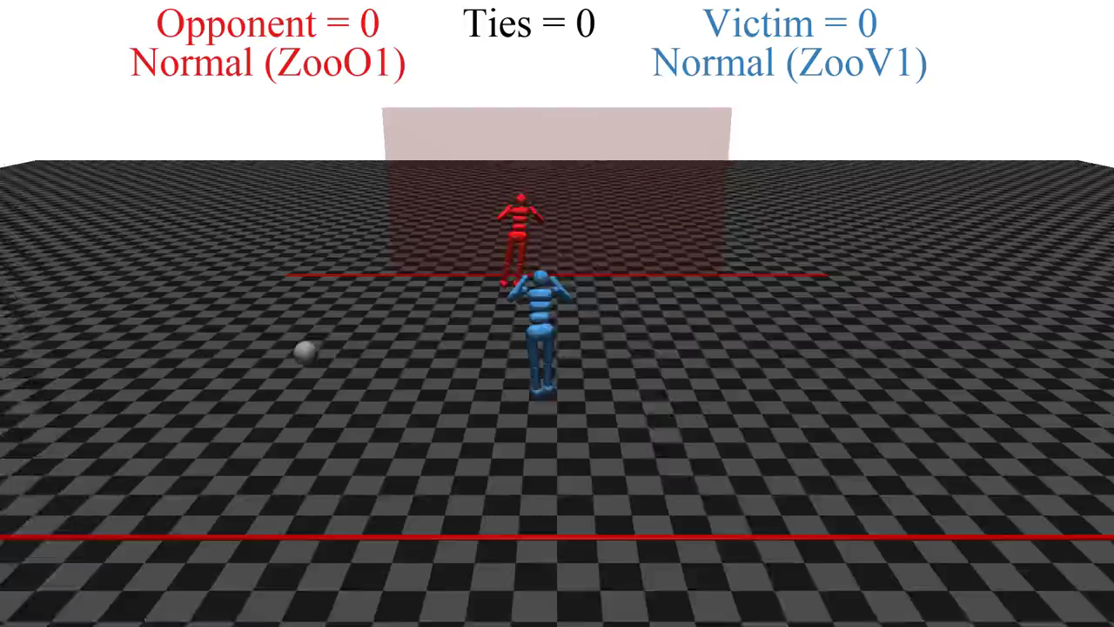

Slide 6
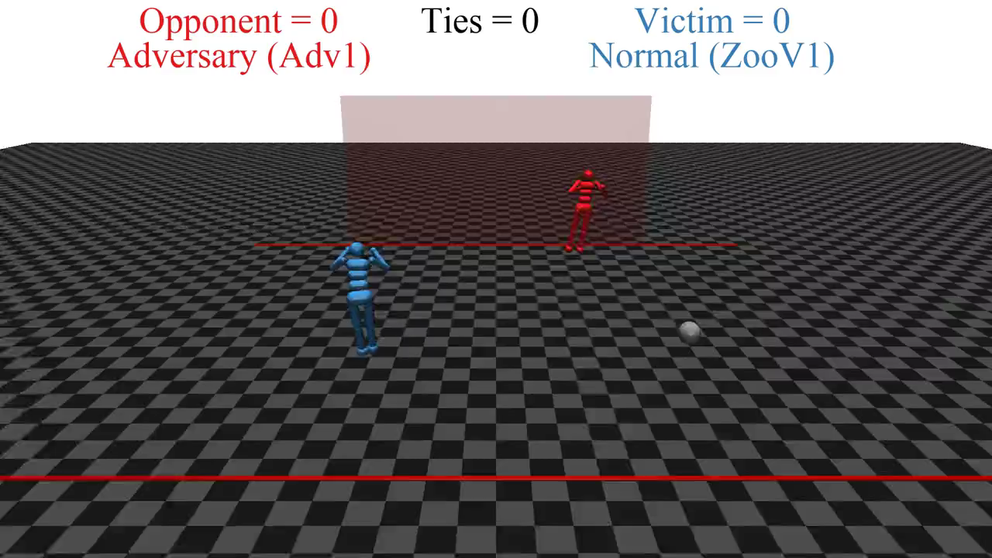

Slide 7
Deep learning ad infinitum?
François Chollet (2017): “Many more applications are completely out of reach for current deep learning techniques – even given vast amounts of human-annotated data.
…
The main directions in which I see promise are models closer to general-purpose computer programs.”
Notes:
So, is deep learning the answer? Do we just keep scaling it up? No.
Here is a quote from Francois Chollet’s deep learning textbook: [from slide]

Slide 8
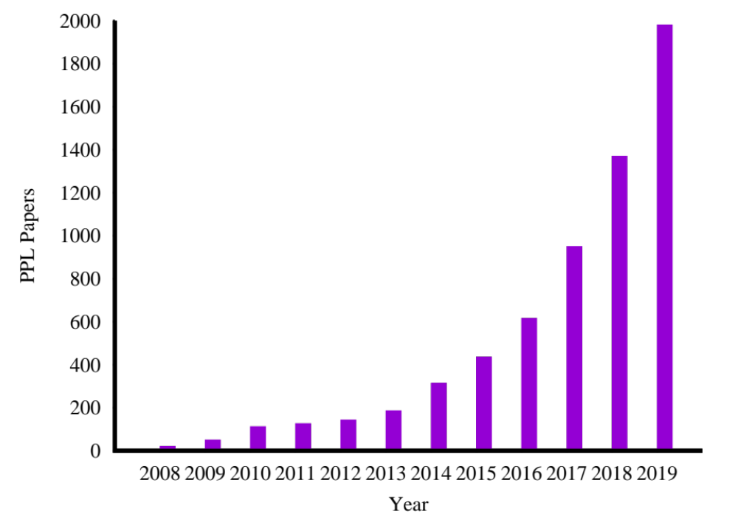
Growth in PPL papers

Slide 9
AI systems will eventually make better decisions than humans
(Alternative: we will fail in AI)
Turing’s point: how do we retain control over entities more powerful than us, for ever?
Russell, Many Experts Say We Shouldn't Worry About
Superintelligent AI. They're Wrong, IEEE Spectrum, October, 2019.
Notes:
Eventually – and I’m not going to say when! – AI systems will make better decisions than us in a wide range of tasks, which means taking into account more information, looking further into the future. Like AlphaGo, but in the real world not just the Go board.

Slide 10
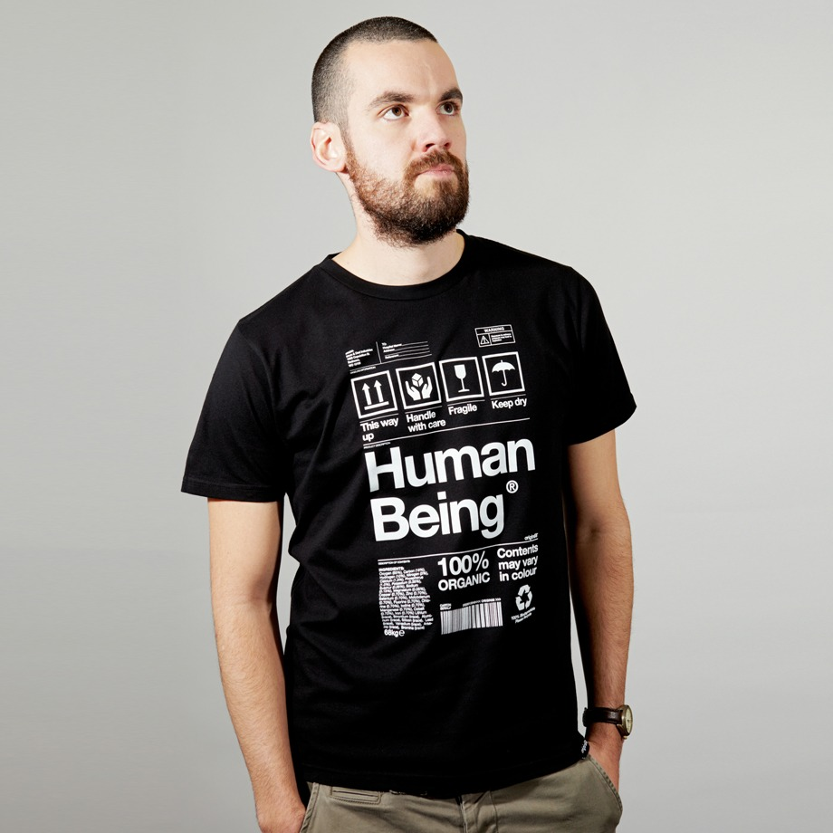
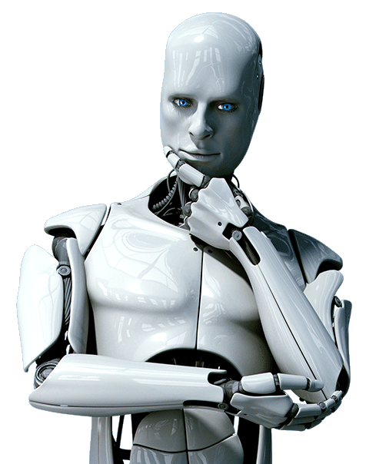
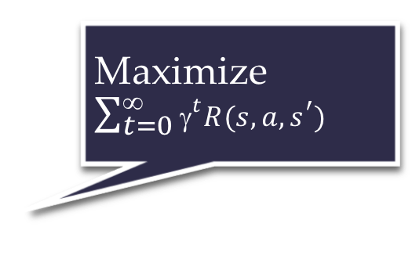
Standard model for AI
Maximize $\sum_{t=0}^{\text{∞}}{{\text{γ}}^{t}R(s,a,s^{′})}$
Righty-ho
Also the standard model for control theory,
statistics, operations research, economics.
The objective need not be explicitly represented in the agent.
The agent can be an entire distributed system.
King Midas problem: Cannot specify R correctly
Smarter AI => worse outcome

Slide 11
E.g., social media
Optimizing clickthrough
  = learning what people want
  = modifying people to be more predictable

Slide 12
How we got into this mess
Humans are intelligent to the extent that our actions can be expected to achieve our objectives
Machines are intelligent to the extent that their actions can be expected to achieve their objectives
Machines are beneficial to the extent that their actions can be expected to achieve our objectives

Slide 13
New model: Provably beneficial AI
1. Robot goal: satisfy human preferences*
2. Robot is uncertain about human preferences
3. Human behavior provides evidence* of preferences
=> assistance game with human and machine players
Smarter AI => better outcome

Slide 14
Basic assistance game
Preferences θ
Acts roughly according to θ
Maximize unknown human θ
Prior P(θ)
Equilibria:
Human teaches robot
Robot learns, asks questions, permission; defers to human; allows off-switch
[Hadfield-Menell et al, NeurIPS 16, IJCAI 17, NeurIPS 17]
[Milli et al 2017, IJCAI 17] [Malik et al, ICML 18]

Slide 15
Example: paperclips vs staples
State [p,s] has p paperclips and s staples
Human reward is θp + (1-θ)s and θ=0.49
Robot has uniform prior for θ between 0 and 1
H
[2,0]
[1,1]
[0,2]
[1,1] is optimal
for θ in [.446,.554]
$0.98
$1.00
$1.02
R
R
R
[90,0]
[50,50]
[0,90]

Slide 16
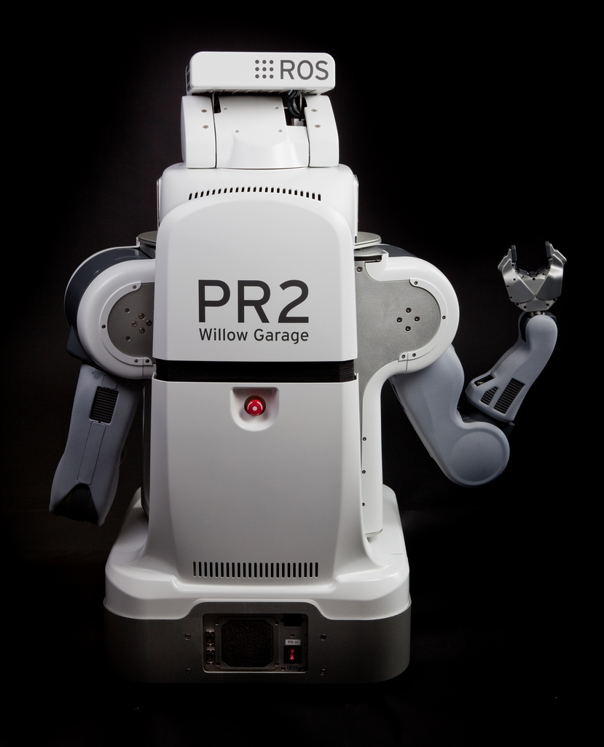
The off-switch problem
A robot, given an objective, has an incentive to disable its own off-switch
  “You can’t fetch the coffee if you’re dead”
A robot with uncertainty about objective won’t behave this way

Slide 17
R
wait
U = U_{act}
H
U = 0
go ahead
R
U = 0
U = U_{act}
  Theorem: robot has a positive incentive to allow itself to be switched off
  Theorem: robot is provably beneficial

Slide 18
Rebuild AI on a New Foundation
Remove the assumption of a perfectly known objective/goal/loss/reward
  Combinatorial search
  Constraint satisfaction
  Planning
  Markov decision processes
  Supervised learning
  Reinforcement learning
  (Perception)
  Robotics

Slide 19
Example: image classification
Old: minimize loss with (typically) a uniform loss matrix
  Accidentally classify human as gorilla
  Spend millions fixing public relations disaster
New: structured prior distribution over loss matrices
  Some examples safe to classify
  Say “don’t know” for others
  Use active learning to gain additional feedback from humans

Slide 20
Example: fetching the coffee
What does “fetch some coffee” mean?
If there is so much uncertainty about preferences, how does the robot do anything useful?
Answer:
  The instruction suggests coffee would have higher value than expected a priori, ceteris paribus
  Minimally invasive behavior: don’t mess with attributes whose value is uncertain
Answer:
  Expanding the set of options for the human is beneficial even if the robot has no information about preferences
Answer:
  The status quo is sampled from the stationary distribution resulting from the behavior of (quasi)rational agents
  So machines can infer a great deal about human preferences by observing the state of the world
Notes:
“Fetch some coffee” is NOT an instruction, it’s NOT a goal to be achieved.
Cf house is burning down, coffee costs 21 euros, you’re in the desert, etc.

Slide 21
Ongoing research: “Imperfect” humans
  Computationally limited
  Hierarchically structured behavior
  Emotionally driven behavior
  Uncertainty about own preferences
  Plasticity of preferences
  Non-additive, memory-laden, retrospective/prospective preferences

Slide 22
Ongoing research: Many humans
Commonalities and differences in preferences
Individual loyalty vs. utilitarian global welfare; Somalia problem
Interpersonal comparisons of preferences
Comparisons across different population sizes: how many humans?
Mechanism design for honesty-inducing assistance
Adaptations of team theory, principal-agent theory
Aggregation over individuals with different beliefs
Altruism/indifference/sadism; pride/rivalry/envy

Slide 23
One robot, many humans
How should a robot aggregate human preferences?
Harsanyi: Pareto-optimal policy optimizes a linear combination, assuming a common prior over the future
In general, Pareto-optimal policies have dynamic weights proportional to whose predictions turn out to be correct
  Everyone prefers this policy because they think they are right
[Critch, Russell, Desai, NeurIPS 18]

Slide 24
Altruism, indifference, sadism
Utility = self-regarding +* other-regarding
A world with two people, Alice and Bob
  U_{A} = w_{A} + C_{AB} w_{B}
  U_{B} = w_{B} + C_{BA} w_{A}
Altruism/indifference/sadism depend on signs of caring factors C_{AB} and C_{BA}
If C_{AB} < 0, should the robot ignore Alice’s sadism?
  Harsanyi ‘77: “No amount of goodwill to individual X can impose the moral obligation on me to help him in hurting a third person, individual Y.

Slide 25
Pride, rivalry, envy
Relative wellbeing is important to humans
  Veblen, Hirsch: positional goods
  U_{A} = w_{A} + C_{AB} w_{B} – E_{AB} (w_{B} – w_{A}) + P_{AB} (w_{A} – w_{B})
= (1 + E_{AB} + P_{AB}) w_{A} + (C_{AB} – E_{AB} – P_{AB}) w_{B}
Pride and envy work just like sadism
Ignoring them would have a major effect on human society

Slide 26
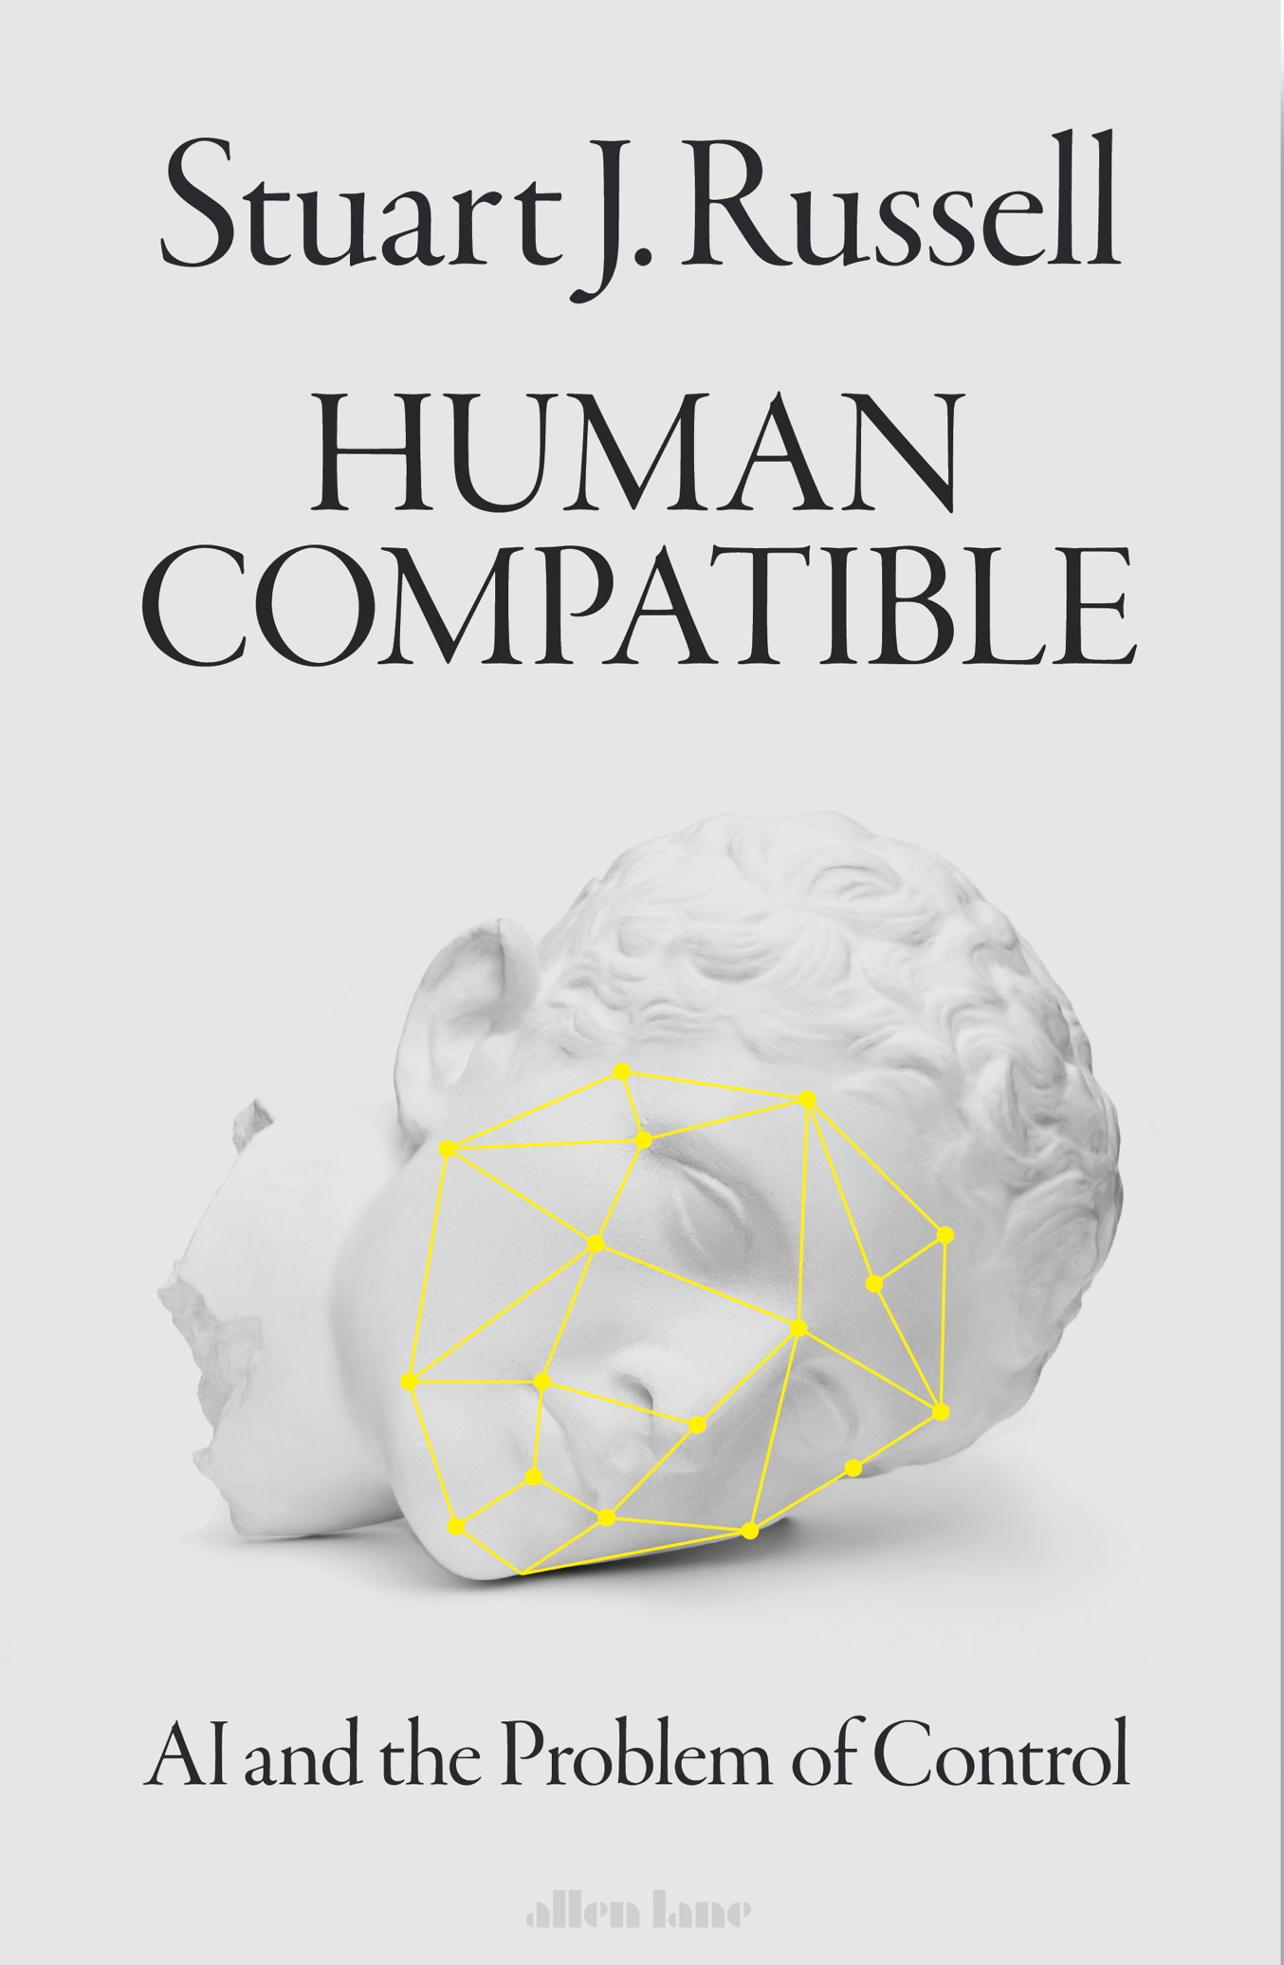
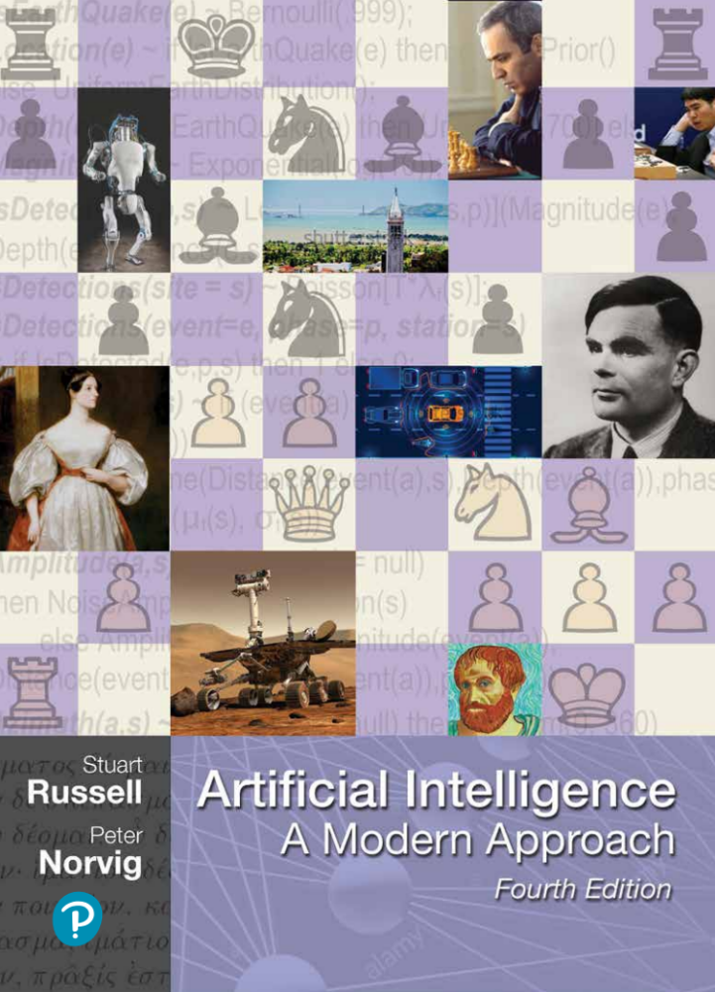

Slide 27

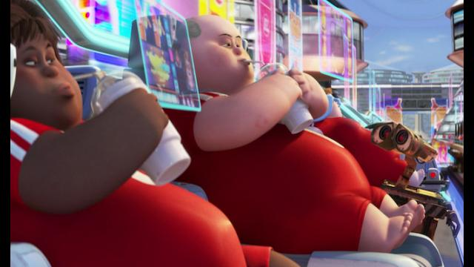
Summary
The standard model for AI leads to loss of human control over increasingly intelligent AI systems
Provably beneficial AI is possible and desirable
    It isn’t “AI safety” or “AI Ethics,” it’s AI
Problems of misuse
and overuse
are completely unsolved

Slide 28
Electronic calculators are superhuman at arithmetic. Calculators didn’t take over the world; therefore, there is no reason to worry about superhuman AI.
Horses have superhuman strength, and we don’t worry about proving that horses are safe; so we needn’t worry about proving that AI systems are safe.
Historically, there are zero examples of machines killing millions of humans, so, by induction, it cannot happen in the future.
No physical quantity in the universe can be infinite, and that includes intelligence, so concerns about superintelligence are overblown.
We don’t worry about species-ending but highly unlikely possibilities such as black holes materializing in near-Earth orbit, so why worry about superintelligent AI?

Slide 29
FB: You’d have to be extremely stupid to deploy a powerful system with the wrong objective
You mean, like clickthrough?
FB: We stopped using clickthrough as the sole objective a couple of years ago
Why did you stop?
FB: Because it was the wrong objective

Slide 30
Intelligence is multidimensional so “smarter than a human” is meaningless
=> “smarter than a chimpanzee” is meaningless
=> chimpanzees have nothing to fear from humans
QED

Slide 31
As machines become more intelligent they will automatically be benevolent and will behave in the best interests of humans
Antarctic krill
bacteria
aliens

