Slide 1
How Not to Destroy the World With AI
Stuart Russell
University of California, Berkeley

Slide 2
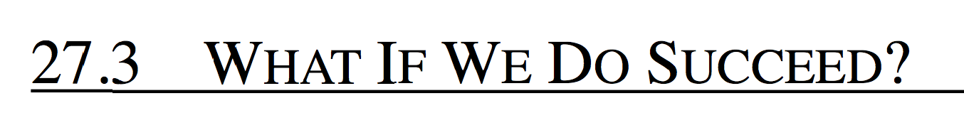
AIMA1e, 1994
In David Lodge’s Small World,, the protagonist causes consternation by asking a panel of eminent but contradictory literary theorists the following question: “What if you were right?” None of the theorists seems to have considered this question before. Similar confusion can sometimes be evoked by asking AI researchers, “What if you succeed?” AI is fascinating, and intelligent computers are clearly more useful than unintelligent computers, so why worry?

Slide 3

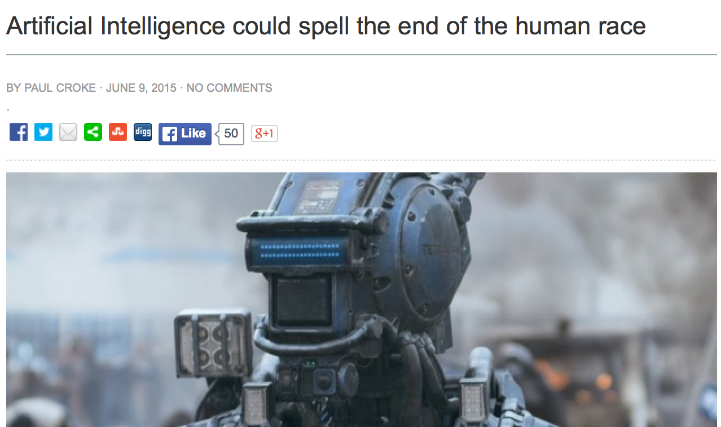

Slide 4
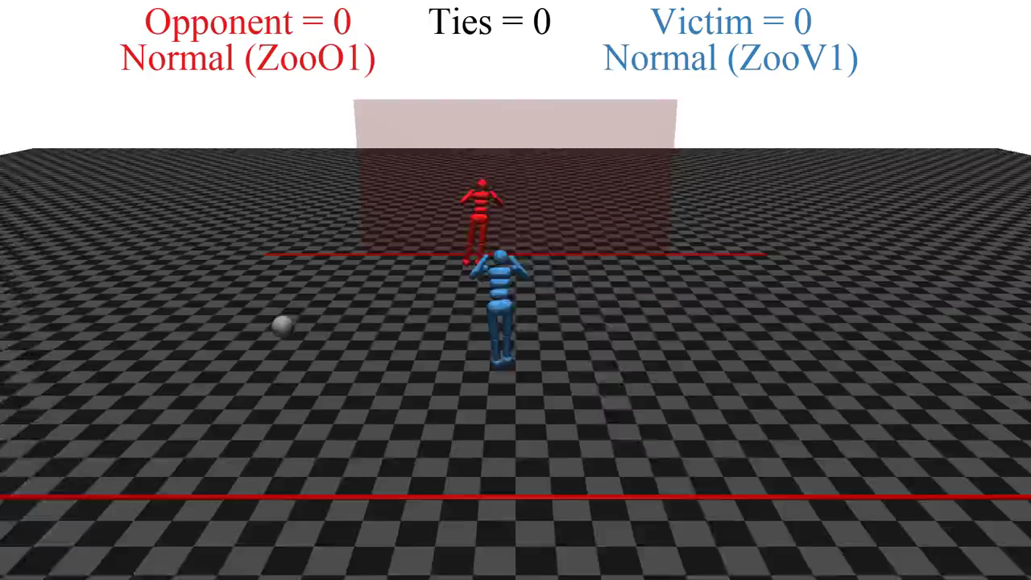

Slide 5
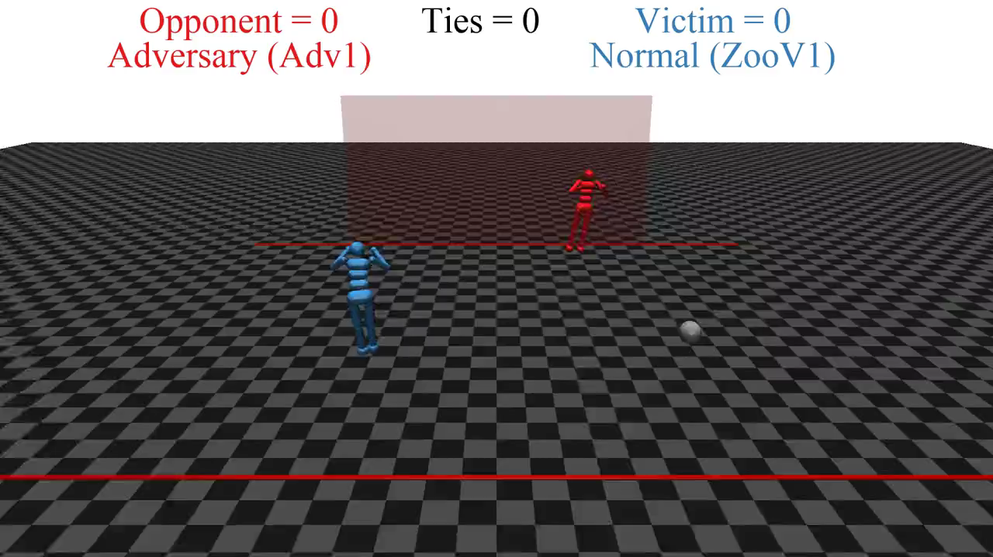

Slide 6
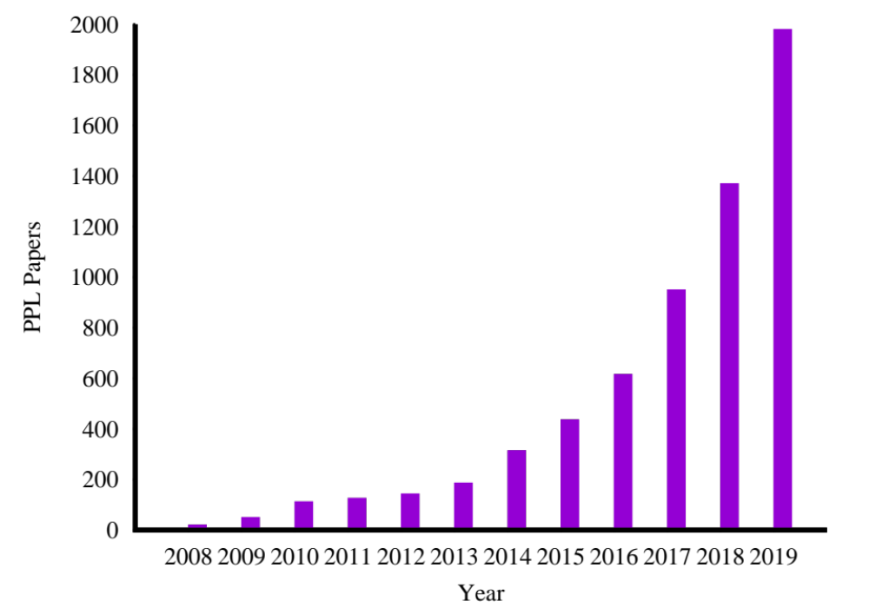
Growth in PPL papers

Slide 7
AI systems will eventually make better decisions than humans
Notes:
Eventually – and I’m not going to say when! – AI systems will make better decisions than us in a wide range of tasks, which means taking into account more information, looking further into the future. Like AlphaGo, but in the real world not just the Go board.

Slide 8
From: Superior Alien Civilization <sac12@sirius.canismajor.u>
To: humanity@UN.org
Subject: Contact
Be warned: we shall arrive in 30-50 years
From: humanity@UN.org
To: Superior Alien Civilization <sac12@sirius.canismajor.u>
Subject: Out of office: Re: Contact
Humanity is currently out of the office. We will respond to your message when we return.
☺

Slide 9
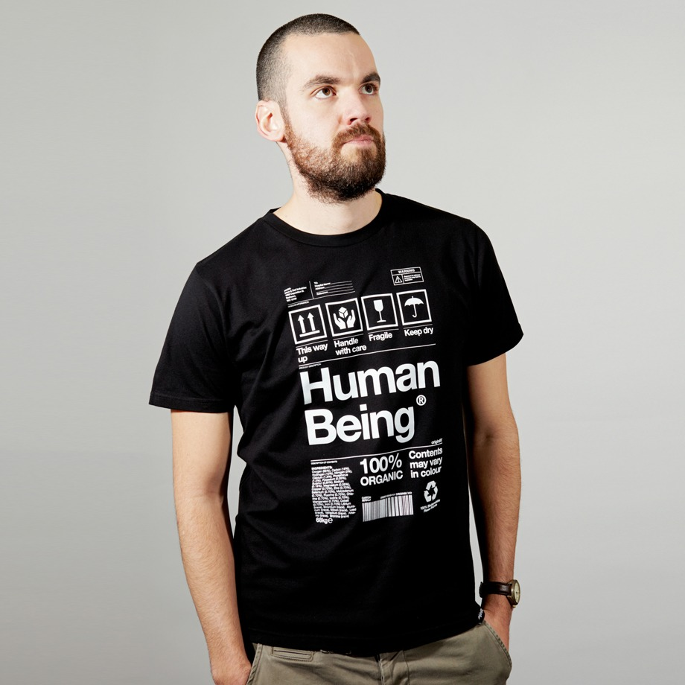
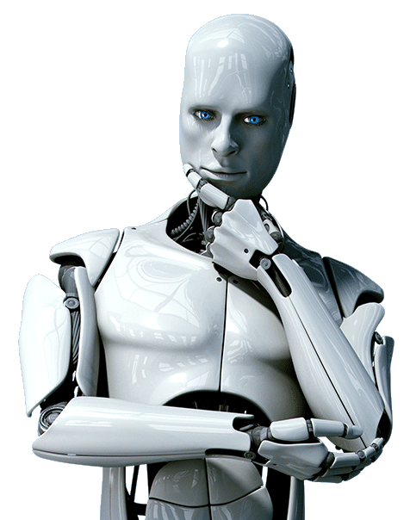
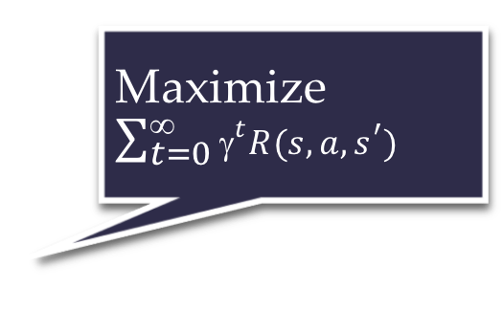
Standard model for AI
Maximize $\sum_{t=0}^{\text{∞}}{{\text{γ}}^{t}R(s,a,s^{′})}$
Righty-ho
Also the standard model for control theory,
statistics, operations research, economics
King Midas problem:
Cannot specify R correctly
Smarter AI => worse outcome

Slide 10
E.g., social media
Optimizing clickthrough
  = learning what people want
  = modifying people to be more predictable

Slide 11
How we got into this mess
Humans are intelligent to the extent that our actions can be expected to achieve our objectives
Machines are intelligent to the extent that their actions can be expected to achieve their objectives
Machines are beneficial to the extent that their actions can be expected to achieve our objectives

Slide 12
New model: Provably beneficial AI
1. Robot goal: satisfy human preferences*
2. Robot is uncertain about human preferences
3. Human behavior provides evidence of preferences
=> assistance game with human and machine players
Smarter AI => better outcome

Slide 13
AIMA 1,2,3: objective given to machine
Human objective
Human behaviour
Machine behaviour

Slide 14
AIMA 1,2,3: objective given to machine
Human objective
Machine behaviour

Slide 15
AIMA 4: objective is a latent variable
Human objective
Human behaviour
Machine behaviour

Slide 16
Example: image classification
Old: minimize loss with (typically) a uniform loss matrix
  Accidentally classify human as gorilla
  Spend millions fixing public relations disaster
New: structured prior distribution over loss matrices
  Some examples safe to classify
  Say “don’t know” for others
  Use active learning to gain additional feedback from humans

Slide 17
Example: fetching the coffee
What does “fetch some coffee” mean?
If there is so much uncertainty about preferences, how does the robot do anything useful?
Answer:
  The instruction suggests coffee would have higher value than expected a priori, ceteris paribus
  Uncertainty about the value of other aspects of environment state doesn’t matter as long as the robot leaves them unchanged
Notes:
“Fetch some coffee” is NOT an instruction, it’s NOT a goal to be achieved.
Cf house is burning down, coffee costs 21 euros, you’re in the desert, etc.

Slide 18
Basic assistance game
Preferences θ
Acts roughly according to θ
Maximize unknown human θ
Prior P(θ)
Equilibria:
Human teaches robot
Robot learns, asks questions, permission; defers to human; allows off-switch
Related to inverse RL, but two-way

Slide 19
Example: paperclips vs staples
State (p,s) has p paperclips and s staples
Human reward is θp + (1-θ)s and θ=0.49
Robot has uniform prior for θ on [0,1]
H
[2,0]
[1,1]
[0,2]
$0.98
$1.00
$1.02
R
R
R
[1,1] is optimal
for θ in [.446,.554]
[90,0]
[50,50]
[0,90]

Slide 20
The off-switch problem
A robot, given an objective, has an incentive to disable its own off-switch
  “You can’t fetch the coffee if you’re dead”
A robot with uncertainty about objective won’t behave this way

Slide 21
R
wait
U = U_{act}
H
U = 0
go ahead
R
U = 0
U = U_{act}
  Theorem: robot has a positive incentive to allow itself to be switched off
  Theorem: robot is provably beneficial

Slide 22
Ongoing research
Efficient algorithms for assistance games
Redo all areas of AI that assume a fixed objective/goal/loss/reward
  Combinatorial search
  Constraint satisfaction
  Planning
  Markov decision processes
  Supervised learning
  Reinforcement learning
  Perception?

Slide 23
Ongoing research: “Imperfect” humans
  Computationally limited
  Hierarchically structured behavior
  Emotionally driven behavior
  Uncertainty about own preferences
  Plasticity of preferences
  Non-additive, memory-laden, retrospective/prospective preferences
  Just generally messed up preferences

Slide 24
Ongoing research: Many humans
Commonalities and differences in preferences
Individual loyalty vs. utilitarian global welfare; Somalia problem
Interpersonal comparisons of preferences
Comparisons across different population sizes: how many humans?
Aggregation over individuals with different beliefs
Altruism/indifference/sadism; pride/rivalry/envy

Slide 25
One robot, many humans
How should a robot aggregate human preferences?
Harsanyi: Pareto-optimal policy optimizes a linear combination, assuming a common prior over the future
Critch, Russell, Desai (NIPS 18): Pareto-optimal policies have dynamic weights proportional to whose predictions turn out to be correct
  Everyone prefers this policy because they think they are right

Slide 26
Altruism, indifference, sadism
Utility = self-regarding +* other-regarding
A world with two people, Alice and Bob
  U_{A} = w_{A} + C_{AB} w_{B}
  U_{B} = w_{B} + C_{BA} w_{A}
Altruism/indifference/sadism depend on signs of caring factors C_{AB} and C_{BA}
If C_{AB} = 0, Alice is happy to steal from Bob, etc.
If C_{AB} = 0 and C_{BA} > 0, optimizing U_{A} + U_{B} typically leaves Alice with more wellbeing (but Bob may be happier)
If C_{AB} < 0, should the robot ignore Alice’s sadism?
  Harsanyi ‘77: “No amount of goodwill to individual X can impose the moral obligation on me to help him in hurting a third person, individual Y.

Slide 27
Pride, rivalry, envy
Relative wellbeing is important to humans
  Veblen, Hirsch: positional goods
  U_{A} = w_{A} + C_{AB} w_{B} – E_{AB} (w_{B} – w_{A}) + P_{AB} (w_{A} – w_{B})
= (1 + E_{AB} + P_{AB}) w_{A} + (C_{AB} – E_{AB} – P_{AB}) w_{B}
Pride and envy work just like sadism (also zero-sum or negative sum)
Ignoring them would have a major effect on human society

Slide 28
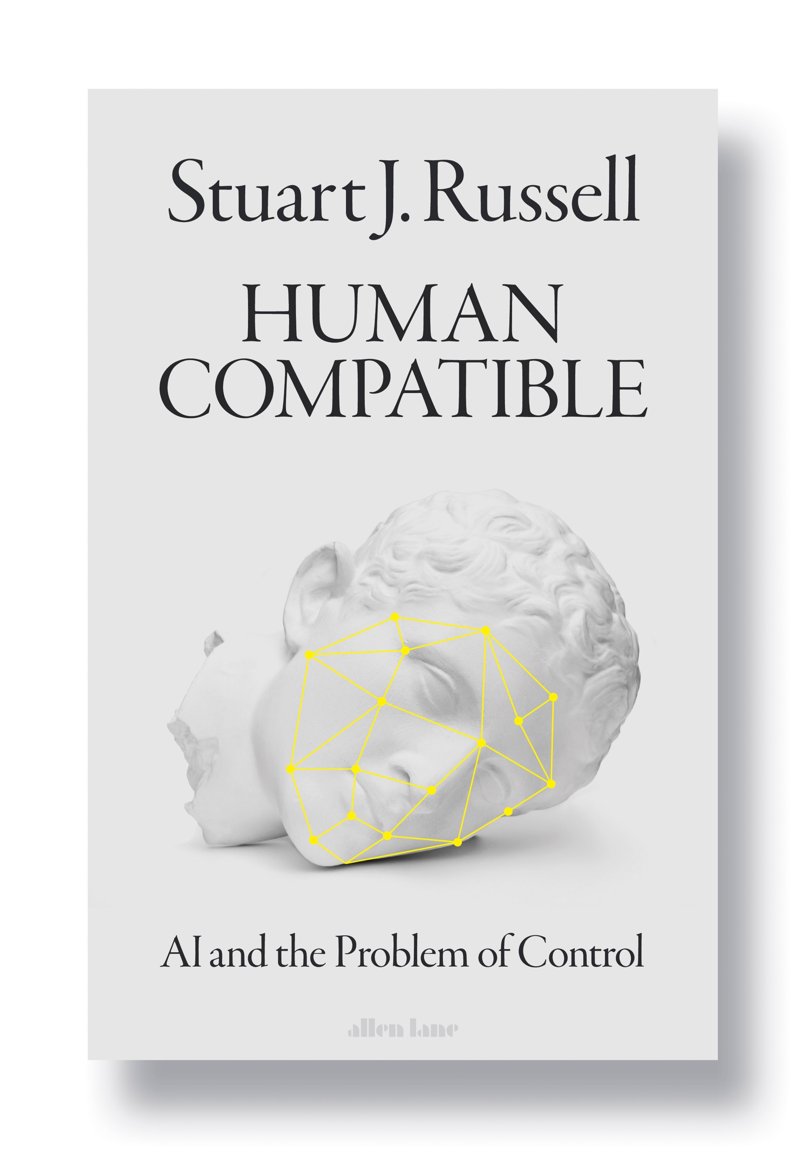

Slide 29
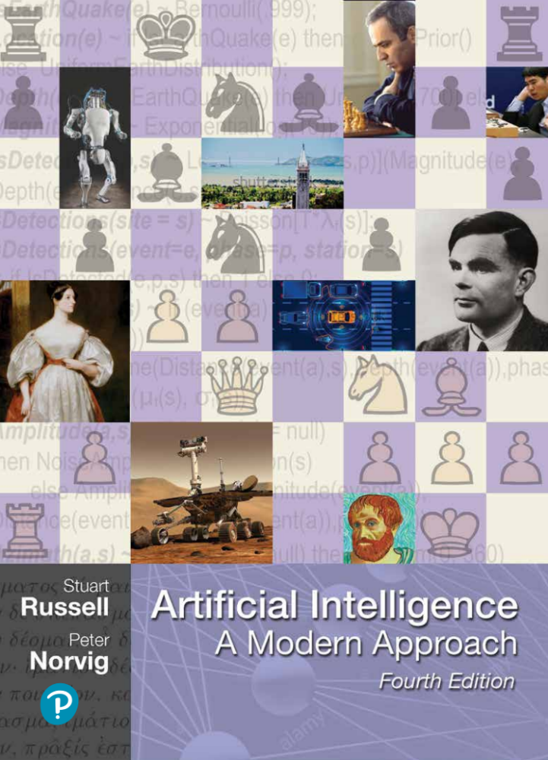

Slide 30
Summary
Provably beneficial AI is possible and desirable
    It isn’t “AI safety” or “AI Ethics,” it’s AI
  Continuing theoretical work (AI, CS, economics)
  Initiating practical work (assistants, robots, cars)
  Inverting human cognition (AI, cogsci, psychology)
  Long-term goals (AI, philosophy, polisci, sociology)

Slide 31


Slide 32
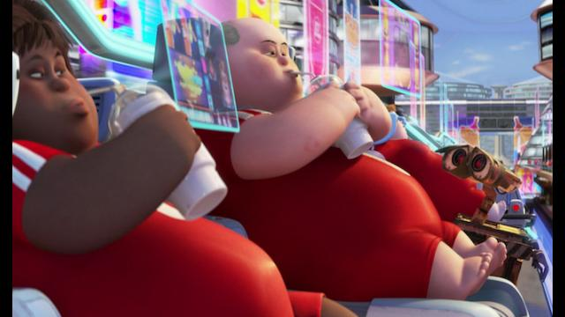

Slide 33
Electronic calculators are superhuman at arithmetic. Calculators didn’t take over the world; therefore, there is no reason to worry about superhuman AI.
Horses have superhuman strength, and we don’t worry about proving that horses are safe; so we needn’t worry about proving that AI systems are safe.
Historically, there are zero examples of machines killing millions of humans, so, by induction, it cannot happen in the future.
No physical quantity in the universe can be infinite, and that includes intelligence, so concerns about superintelligence are overblown.
We don’t worry about species-ending but highly unlikely possibilities such as black holes materializing in near-Earth orbit, so why worry about superintelligent AI?

Slide 34
You’d have to be extremely stupid to deploy a powerful system with the wrong objective
You mean, like clickthrough?
We stopped using clickthrough as the sole objective a couple of years ago
Why did you stop?
Because it was the wrong objective

Slide 35
Intelligence is multidimensional so “smarter than a human” is meaningless
=> “smarter than a chimpanzee” is meaningless
=> chimpanzees have nothing to fear from humans
QED

Slide 36
As machines become more intelligent they will automatically be benevolent and will behave in the best interests of humans
Antarctic krill
bacteria
aliens

