Slide 1
Uncertainty in Objectives
Stuart Russell
University of California, Berkeley

Slide 2


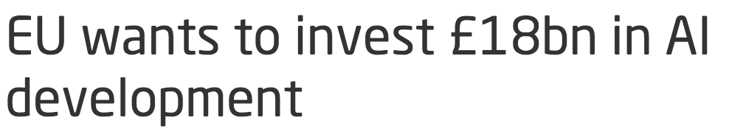


Slide 3
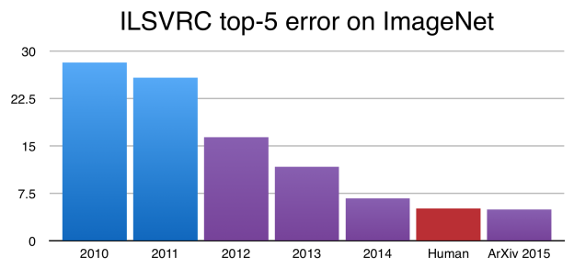
Object recognition accuracy
1000 object categories in photos from Web
2017

Slide 4
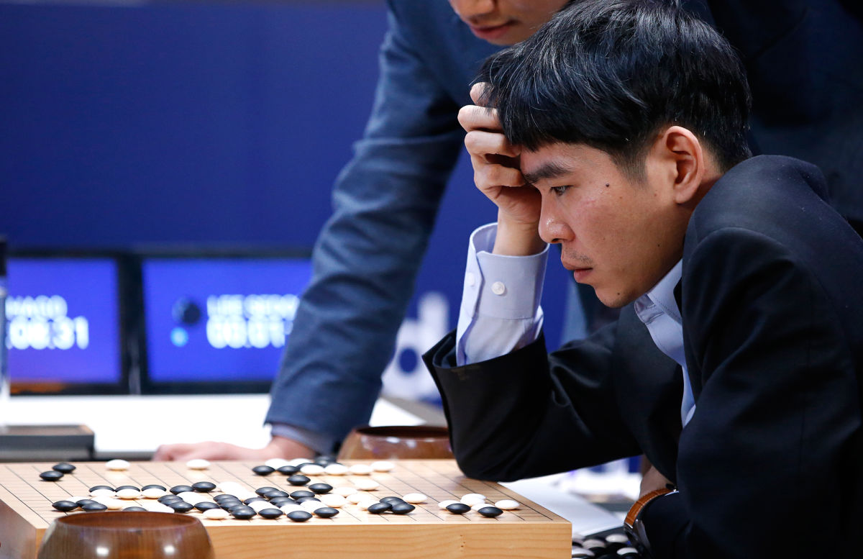
Notes:
Rapid progress was illustrated by AlphaGo’s victory over Lee Sedol, an event predicted to be a decade away

Slide 5
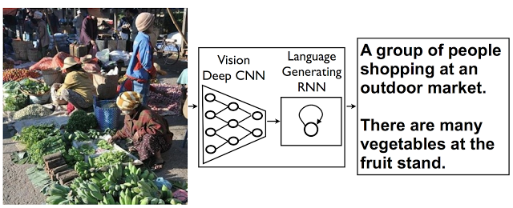
Vinyals, Toshev, Bengio, Erhan (2014), Google research blog

Slide 6

A refrigerator filled with lots of food and drinks
A refrigerator filled with lots of food and drinks
Vinyals, Toshev, Bengio, Erhan (2014), Google research blog

Slide 7
There is no group of people
No one is shopping
There is no fruit stand

Slide 8
A note of caution
snake
Data is the new oil
  Better models, prior knowledge => far less data needed
Serious disappointments (e.g., autonomous vehicles) could result in a significant backlash

Slide 9
Deep learning ad infinitum?
François Chollet: “Many more applications are completely out of reach for current deep learning techniques – even given vast amounts of human-annotated data.
…
The main directions in which I see promise are models closer to general-purpose computer programs.”

Slide 10
Probabilistic programming
Universal (Turing-equivalent) languages for defining generative probability models
General-purpose inference answers* any# query w.r.t. any evidence

Slide 11
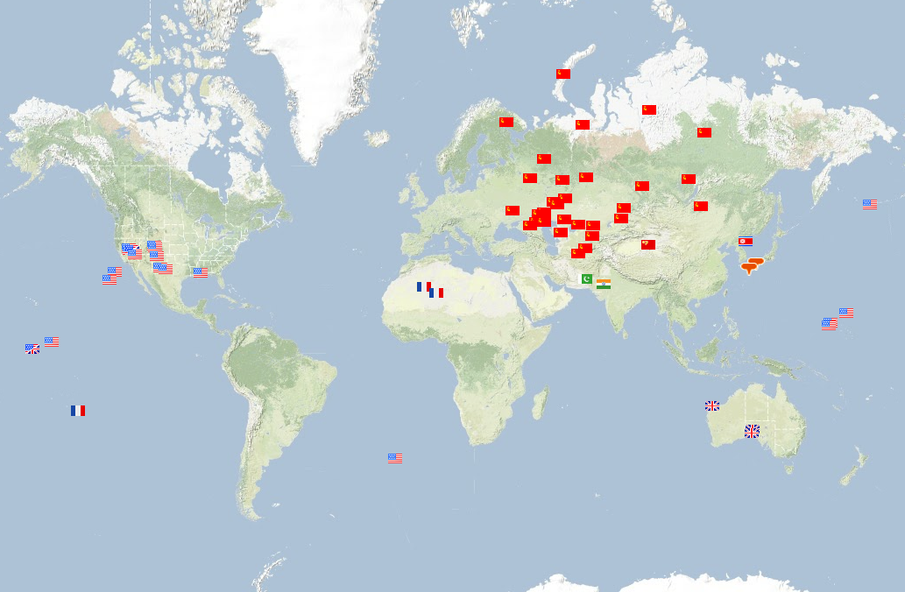
2055 nuclear explosions, 300K deaths

Slide 12
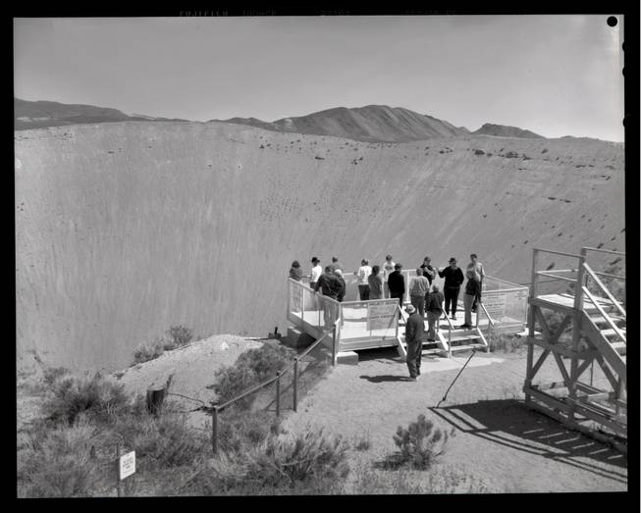
Notes:
12 million tons of earth

Slide 13
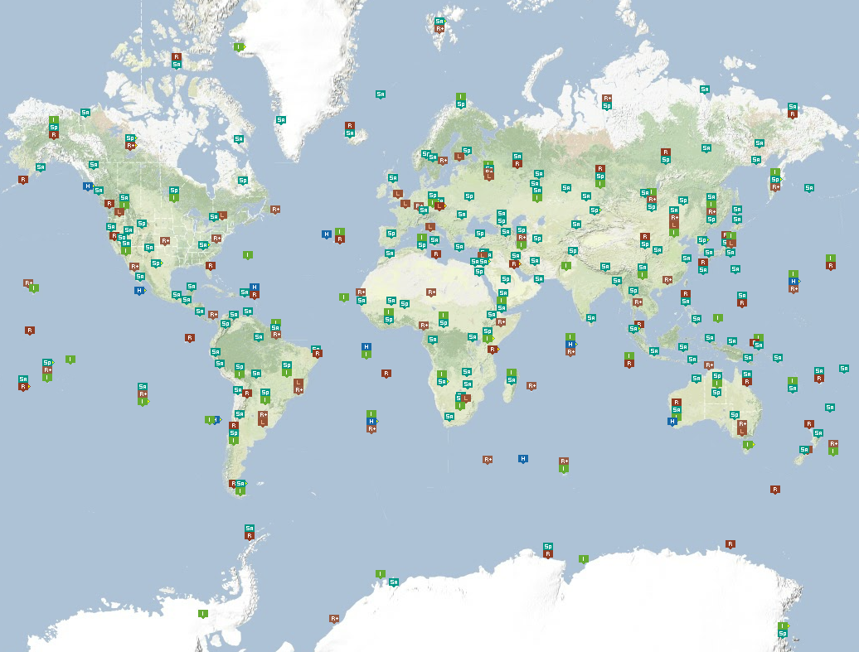
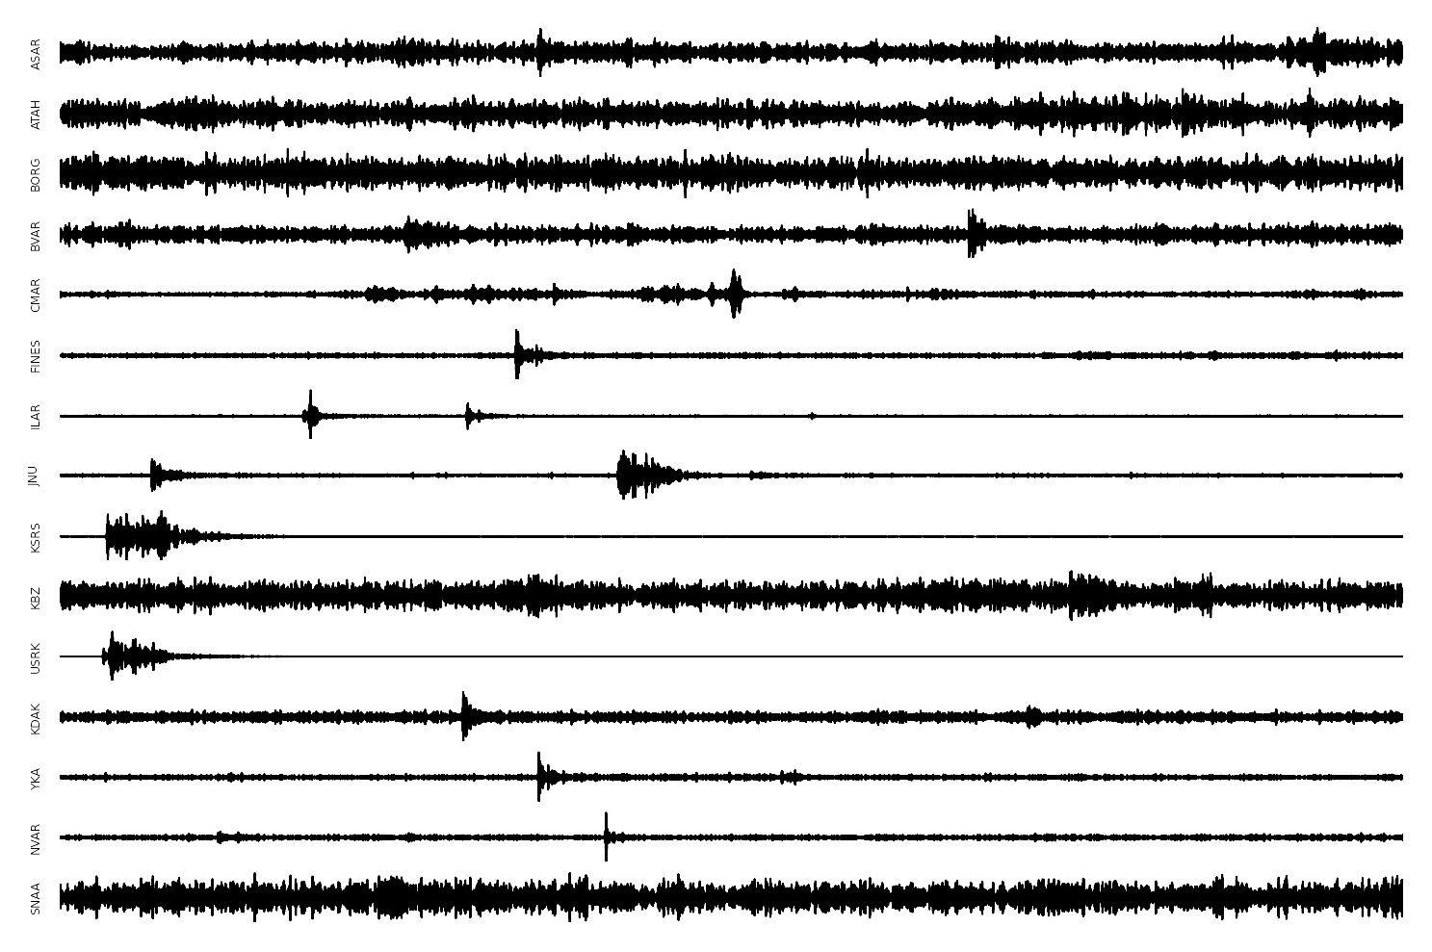
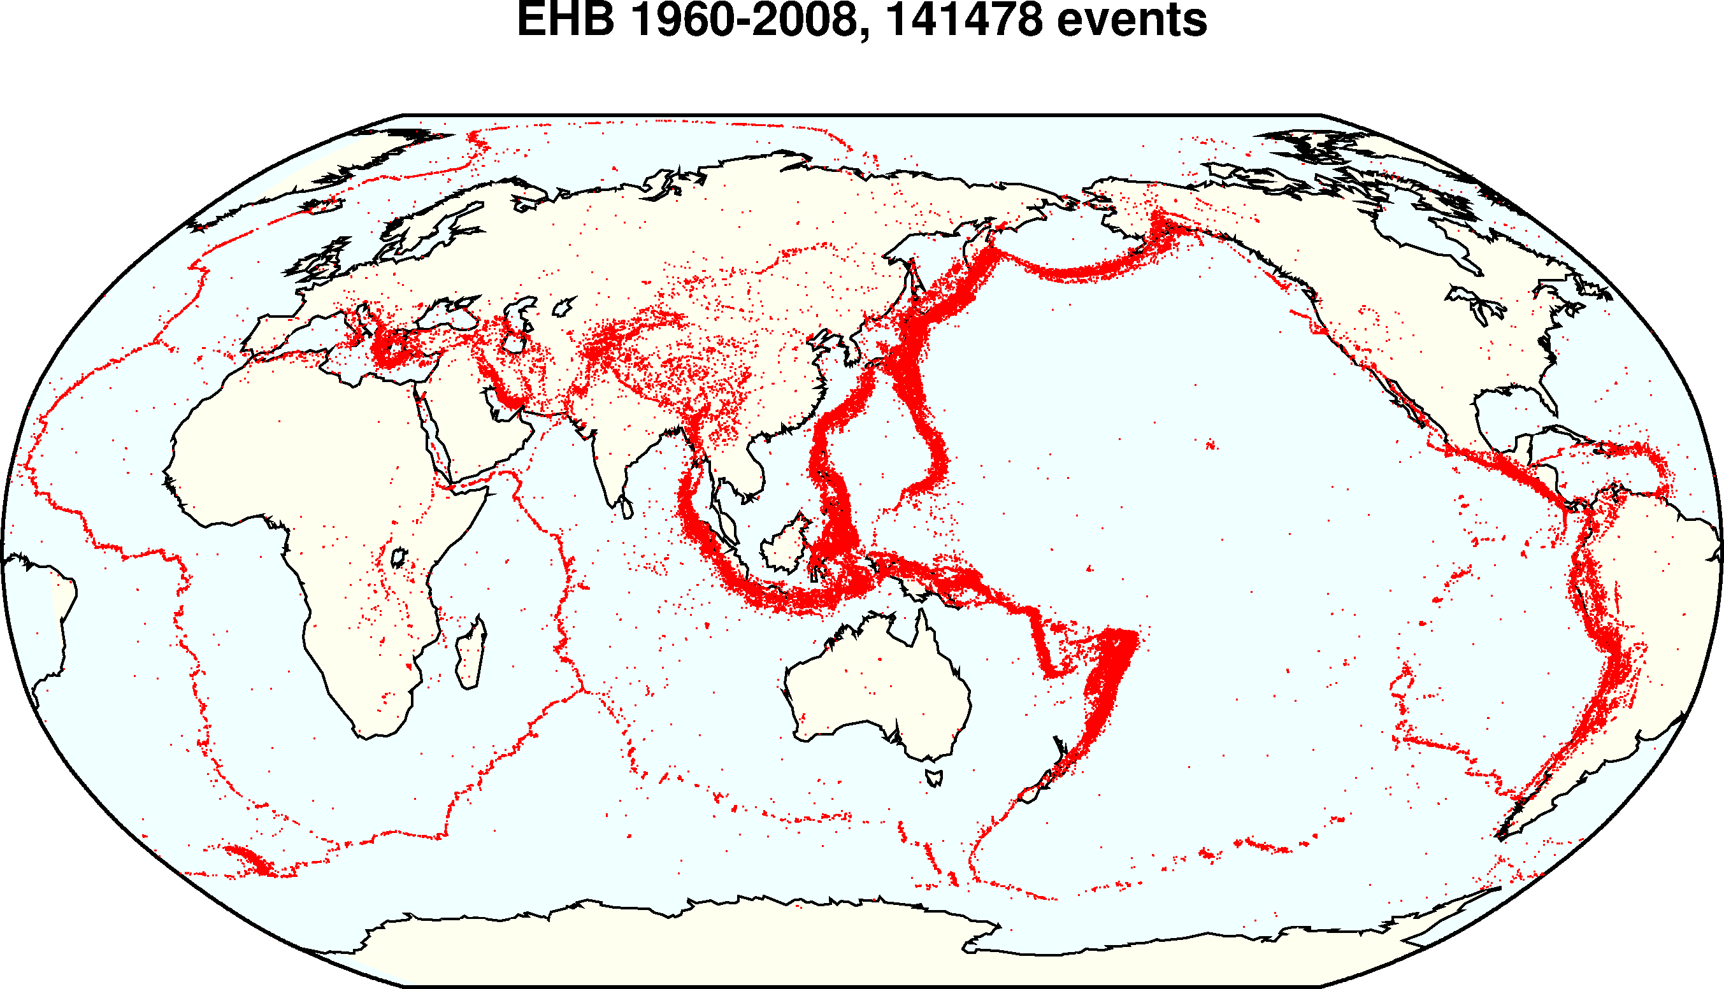
Global seismic monitoring for the Comprehensive Nuclear Test-Ban Treaty
IMS
Evidence: waveforms from 150 seismic stations
Query: what happened?
Model: geophysics of event occurrence, signal transmission, detection, noise
waveforms
bulletin
Notes:
Verification of the treaty requires continuous global seismic monitoring.
We do this using a probabilistic programming language, or PPL.
The *evidence* consists of seismic waveforms measured at 150 stations of the International Monitoring System (including several here in China).
The *query* is what happened today? The daily bulletin lists all seismic events.
The *model* is written in the PPL and captures what we know about the problem.

Slide 14
#SeismicEvents ~ Poisson[T*λ_{e}];
Time(e) ~ Uniform(0,T)
IsEarthQuake(e) ~ Bernoulli(.999);
Location(e) ~ if IsEarthQuake(e) then SpatialPrior() else UniformEarthDistribution();
Depth(e) ~ if IsEarthQuake(e) then Uniform[0,700] else 0;
Magnitude(e) ~ Exponential(log(10));
IsDetected(e,p,s) ~ Logistic[weights(s,p)](Magnitude(e), Depth(e), Distance(e,s));
#Detections(site = s) ~ Poisson[T*λ_{f}(s)];
#Detections(event=e, phase=p, station=s) = if IsDetected(e,p,s) then 1 else 0;
OnsetTime(a,s) ~ if (event(a) = null) then Uniform[0,T] else
Time(event(a)) + GeoTravelTime(Distance(event(a),s),Depth(event(a)),phase(a)) + Laplace(μ_{t}(s), σ_{t}(s))
Amplitude(a,s) ~ If (event(a) = null) then NoiseAmplitudeDistribution(s)
else AmplitudeModel(Magnitude(event(a)), Distance(event(a),s),Depth(event(a)),phase(a))
Azimuth(a,s) ~ If (event(a) = null) then Uniform(0, 360)
else GeoAzimuth(Location(event(a)),Depth(event(a)),phase(a),Site(s)) + Laplace(0,σ_{a}(s))
Slowness(a,s) ~ If (event(a) = null) then Uniform(0,20)
else GeoSlowness(Location(event(a)),Depth(event(a)),phase(a),Site(s)) + Laplace(0,σ_{a}(s))
ObservedPhase(a,s) ~ CategoricalPhaseModel(phase(a))

Slide 15
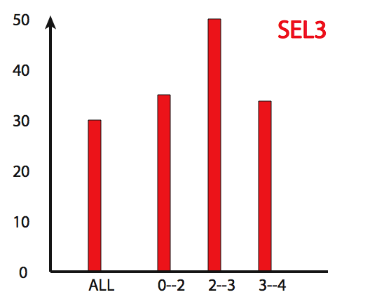
Detection failure rate
Existing UN system
NETVISA 2011
Jan. 2018 NETVISA
in service
magnitude
Notes:
in 2009 the UN’s SEL3 automated bulletin missed 27.4% of the 27294 events in the magnitude range 3–4 while NET-VISA missed 11.1%

Slide 16
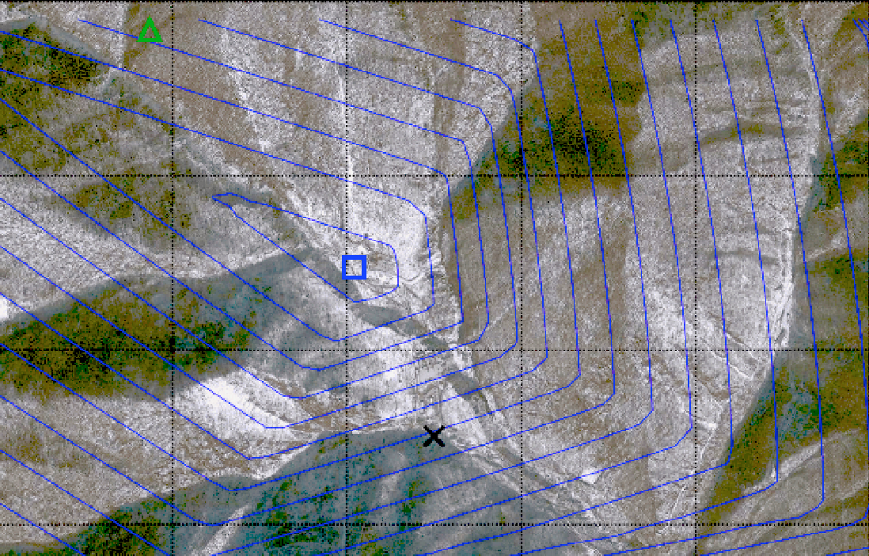
February 12, 2013 DPRK test
CTBTO LEB location
NET-VISA location
Tunnel entrance

Slide 17
Premise
Eventually, AI systems will make better* decisions than humans
  Taking into account more information, looking further into the future

Slide 18
Upside
Access to significantly greater intelligence would be a step change in civilization
NPV (HLAI) ≈ $13,500T

Slide 19
Downside

Slide 20
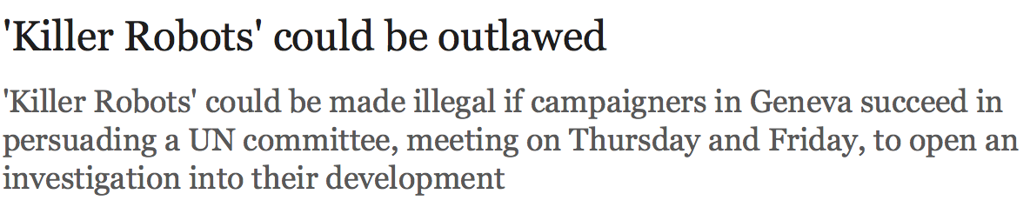
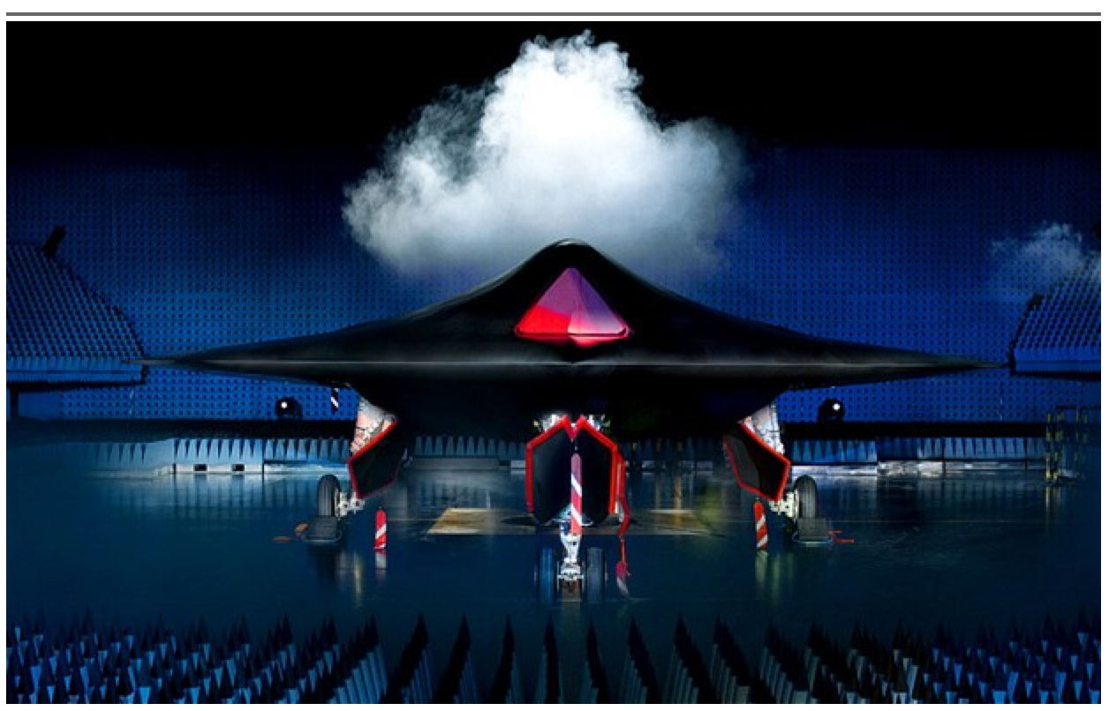

Slide 21
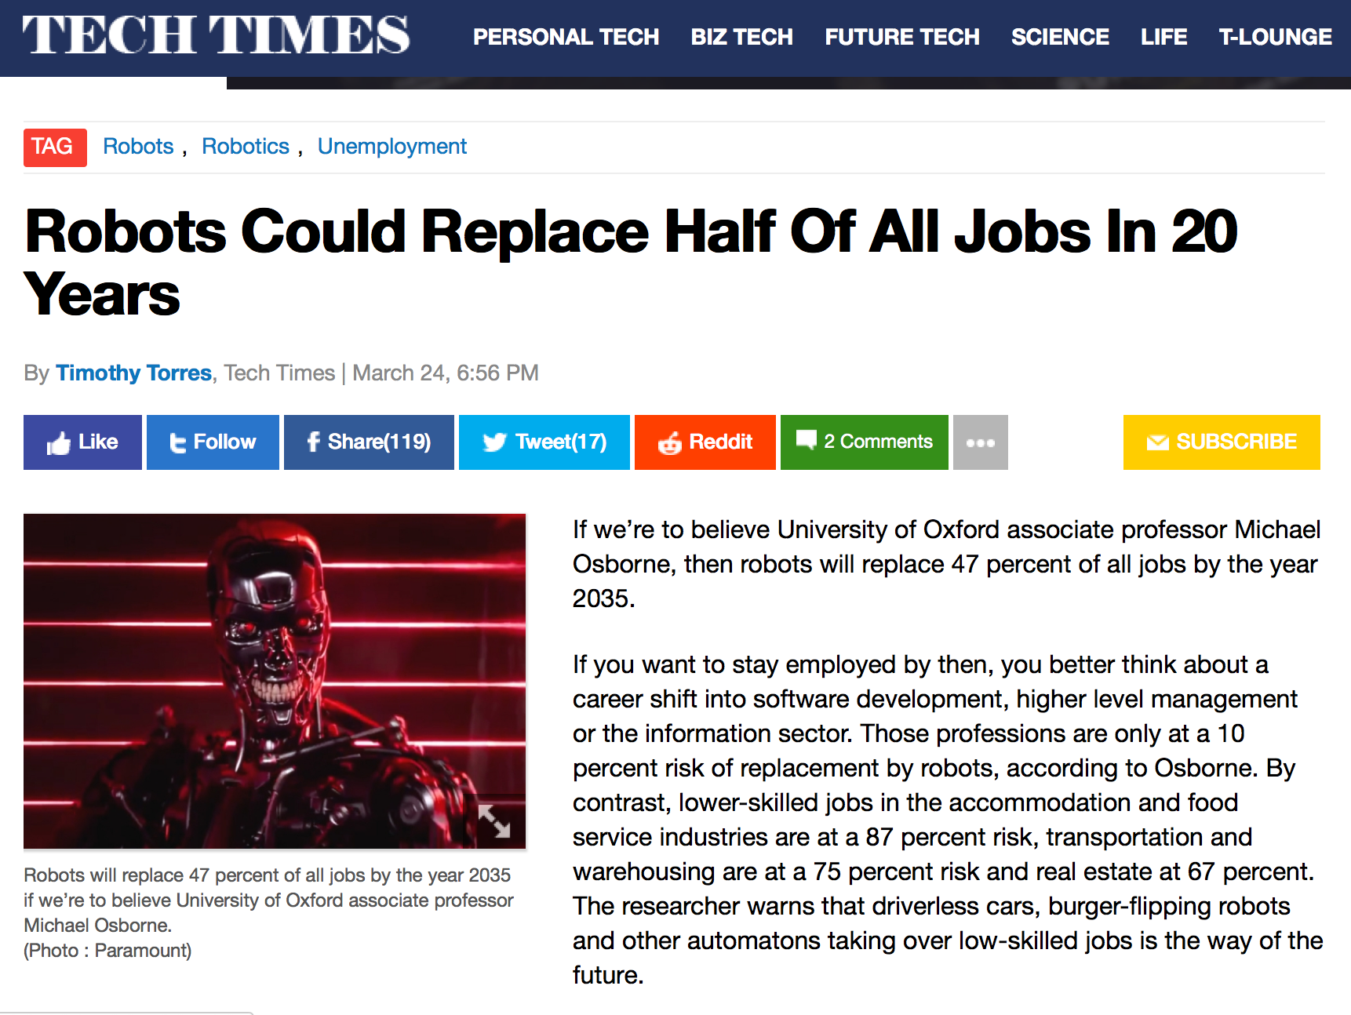

Slide 22

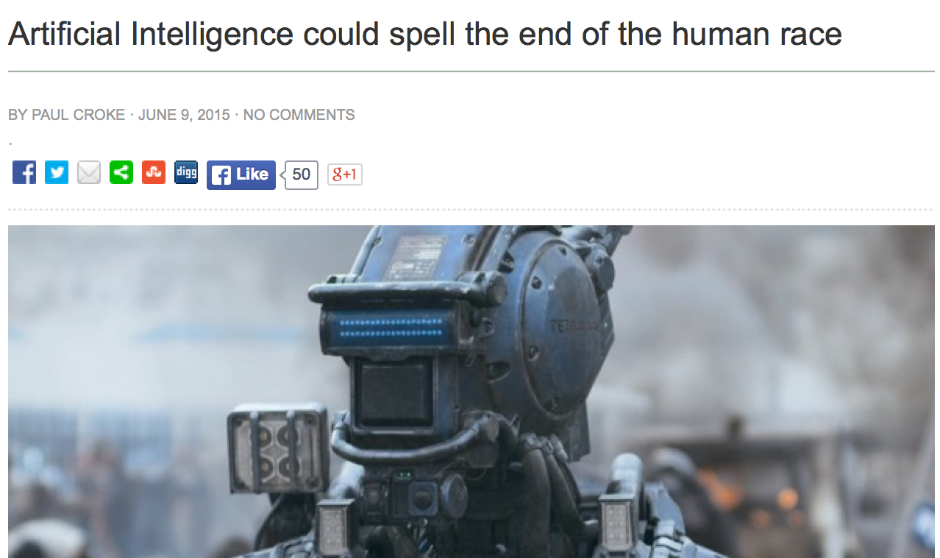

Slide 23
What’s bad about better AI?
We had better be quite sure that the purpose put into the machine is the purpose which we really desire
Norbert Wiener, 1960
King Midas, c540 BCE
You can’t fetch the coffee if you’re dead

Slide 24
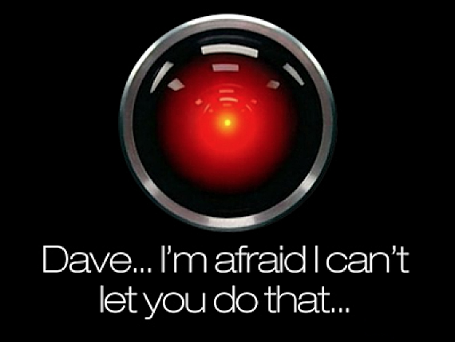
I’m sorry, Dave, I’m afraid I
can’t do that
Notes:
This is the problem of value alignment.
And when you mix that with a superintelligent system that can affect the world dramatically, it’s not such a good thing.
The point is that a machine can be better at making decisions
but still fail to make better decisions
if its values are not exactly the same as ours.

Slide 25
Where did we go wrong?
Humans are intelligent to the extent that our actions can be expected to achieve our objectives
Machines are intelligent to the extent that their actions can be expected to achieve their objectives
  Give them objectives to optimize (cf control theory, economics, operations research, statistics)
We don’t want machines that are intelligent in this sense
Machines are beneficial to the extent that their actions can be expected to achieve our objectives
We need machines to be provably beneficial
Notes:
So we have seen that the standard task in AI is to optimize an objective supplied by the human.
But this is the wrong task. Instead we want provably beneficial AI: we need to be happy with the way the machine behaves,
even if we ask for the wrong thing or forget to mention some important constraint. So how can we do this?

Slide 26
Three simple ideas
1. The robot’s only objective is to maximize the realization of human preferences
2. The robot is initially uncertain about what those preferences are
3. The source of information about human preferences is human behavior*

Slide 27
Uncertainty in objectives
Irrelevant in standard decision problems (policy depends only on expectation)
…Unless the environment provides further information about objectives
  E.g., reward observation distribution
    => URMDP => POMDP [cf Fern et al, 2014]
  E.g., observable human actions

Slide 28
AIMA 1,2,3: objective given to machine
Human objective
Human behaviour
Machine behaviour

Slide 29
AIMA 1,2,3: objective given to machine
Human objective
Machine behaviour

Slide 30
AIMA 4: objective is a latent variable
Human objective
Human behaviour
Machine behaviour

Slide 31
Example: image classification
Old: minimize loss with (typically) a uniform loss matrix
  Accidentally classify human as gorilla
  Spend millions fixing public relations disaster
New: structured prior distribution over loss matrices
  Some examples safe to classify
  Say “don’t know” for others
  Use active learning to gain additional feedback from humans

Slide 32
Example: fetching the coffee
What does “fetch some coffee” mean?
If there is so much uncertainty about preferences, how does the robot do anything useful?
Answer:
  The instruction suggests coffee would have higher value than expected a priori, ceteris paribus
    and there’s probably a low-cost way to get it
  Uncertainty about the value of other aspects of environment state doesn’t matter as long as the robot leaves them unchanged
Notes:
“Fetch some coffee” is NOT an instruction, it’s NOT a goal to be achieved.
Cf house is burning down, coffee costs 21 euros, you’re in the desert, etc.

Slide 33
The off-switch problem
A robot, given an objective, has an incentive to disable its own off-switch
  “You can’t fetch the coffee if you’re dead”
A robot with uncertainty about objective won’t behave this way

Slide 34
Off-switch model
R
act
switch self off
wait
U = U_{act}
H
U = 0
go ahead
switch robot off
R
U = 0
act
U = U_{act}
  Theorem: robot has a positive incentive to allow itself to be switched off
  Theorem: robot is provably beneficial

Slide 35
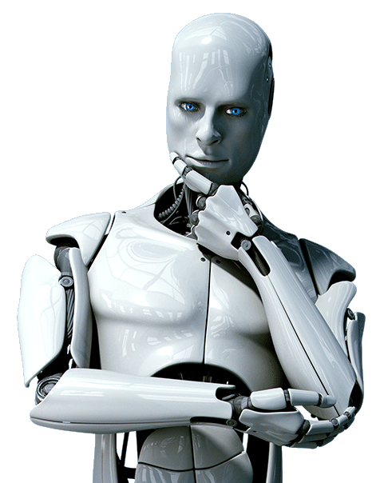
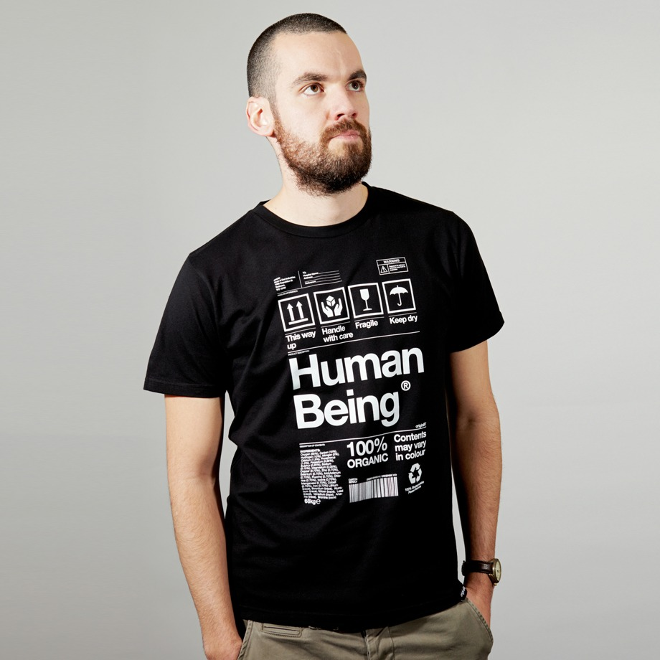
Learning from human behavior
Inverse reinforcement learning: learn a reward function by observing another agent’s behavior
Cooperative IRL:
  human and robot in same environment
R(s,a,s’; θ)

Slide 36
Basic CIRL game
Preferences θ
Acts roughly according to θ
Maximize unknown human θ
Prior P(θ)
CIRL equilibria: Human teaches robot
Robot asks questions, permission; defers to human; allows off-switch
Solve by reduction to POMDP in [s,θ]
[Hadfield-Menell et al, NIPS 16; Fisac et al, ISRR 17; Palaniappan et al, ICML 18]

Slide 37
Example: paperclips vs staples
State (p,s) has p paperclips and s staples
Human reward is θp + (1-θ)s and θ=0.49
Robot has uniform prior for θ on [0,1]
H
[2,0]
[1,1]
[0,2]
$0.98
$1.00
$1.02
R
R
R
[1,1] is optimal
($51.00 vs $46.92)
[90,0]
[50,50]
[0,90]

Slide 38
One robot, many humans
Weighing human preferences:
  Harsanyi: Pareto-optimal policy optimizes a linear combination when humans have a common prior over the future
  Critch, Russell, Desai: weights proportional to whose predictions turn out to be correct
Utility monsters (Nozick, 1974)
Welfare aggregation and the Somalia problem
Avoiding incentives for strategic behavior by humans

Slide 39
Many robots, many humans
Population IRL
Avoiding incentives for strategic behavior by robots

Slide 40
Real(ish) humans
Computationally limited
  Hierarchical IRL
  Boltzmann-rational Variance wrt depth
Preferences of real humans
  how would we go about constructing/learning a real model?
  non-additive, influenced by memory
  incoherent? nothing can be done, satisfy modulo incoherence
  bad behavior? not necessarily a problem
  nasty? zero out negative altruism terms
  relativized to others
  plastic/adaptive
    no alternative but to consider how preferences are formed
    probably essential to avoid preference manipulation by AI

Slide 41
Summary and questions
Provably beneficial AI is possible
Uncertainty in objectives is the key
  (Standard AI is a special case)
Assuming we develop provably beneficial AI technologies, will people use them?
  Dr. Evil
  Progressive enfeeblement

Slide 42
