Slide 1
Killer Robots, the End of Humanity, and All That
What’s a good AI researcher to do?
Stuart Russell
University of California, Berkeley

Slide 2
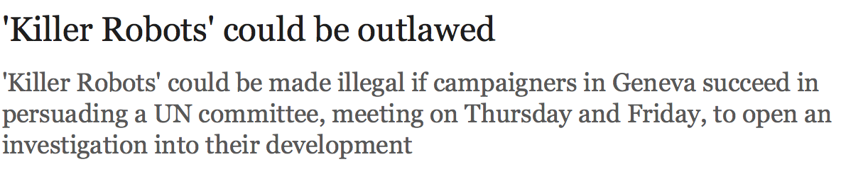
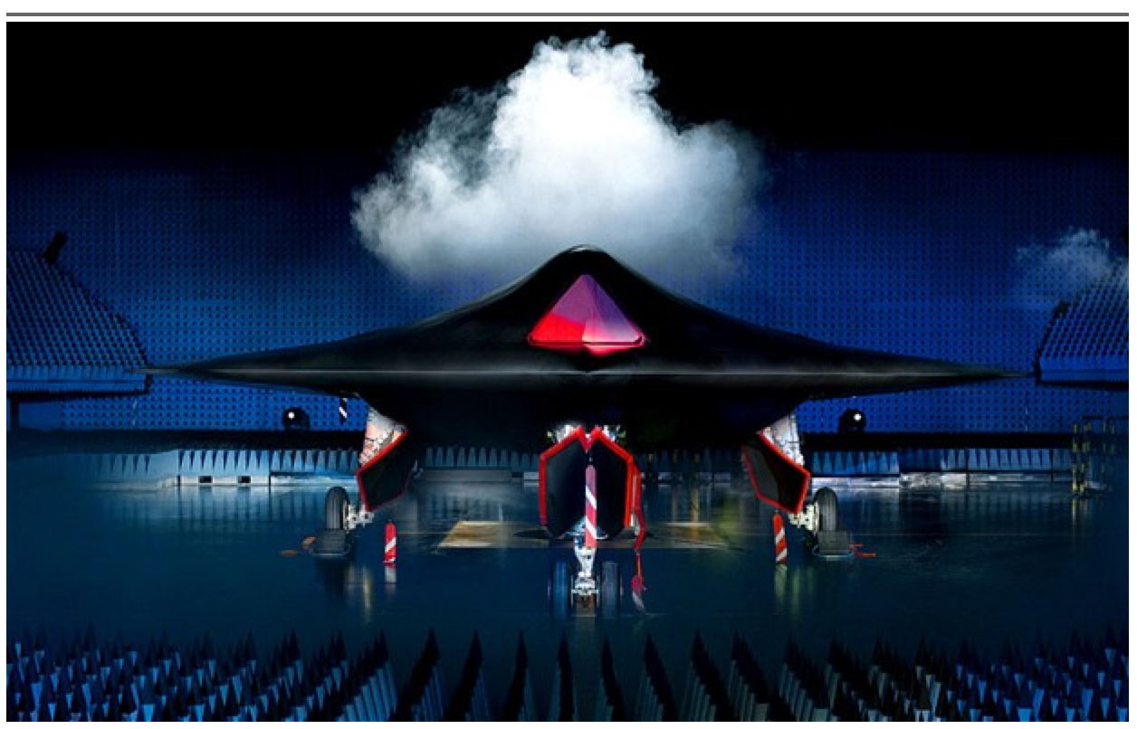

Slide 3
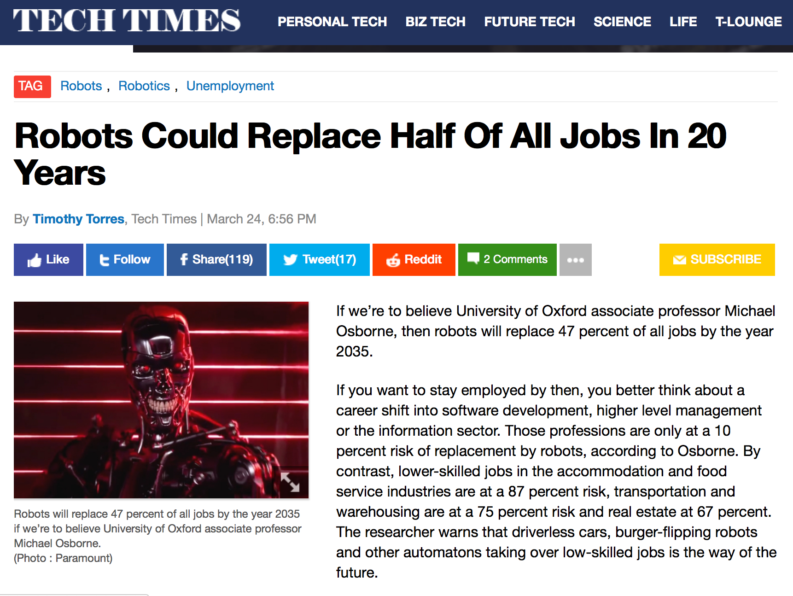

Slide 4

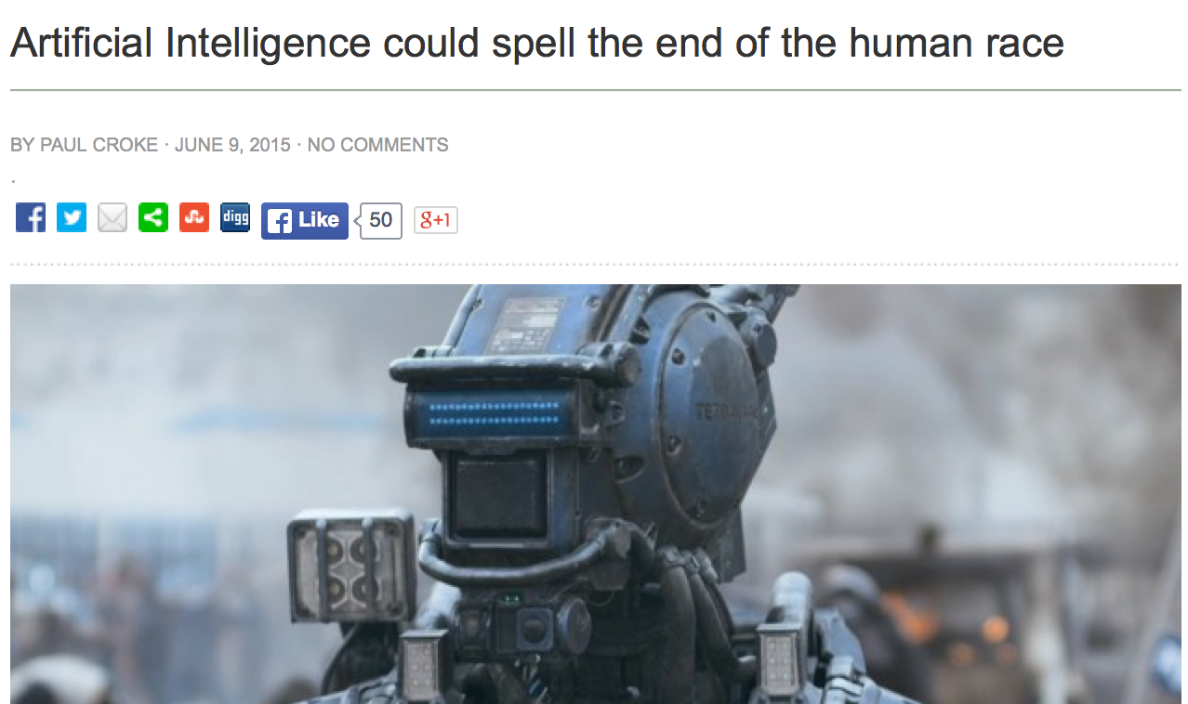

Slide 5


Slide 6
OK, what else??
Don’t take the media literally
  Corollary: Don’t expect the media to report your opinions accurately
Take it as a compliment
Read the arguments and reach your own opinion
Remember why we’re doing AI

Slide 7
Why are we doing AI?
To create intelligent systems
  The more intelligent, the better
We believe we can succeed
  Limited only by ingenuity and physics
Everything civilization offers is the product of intelligence
If we can amplify our intelligence, the benefits to humanity are immeasurable

Slide 8
Progress is accelerating
Solid theoretical foundations
Very large increases in computational and data resources
Huge investments from industry
  Technologies emerging from the lab
Real-world impact is inevitable

Slide 9
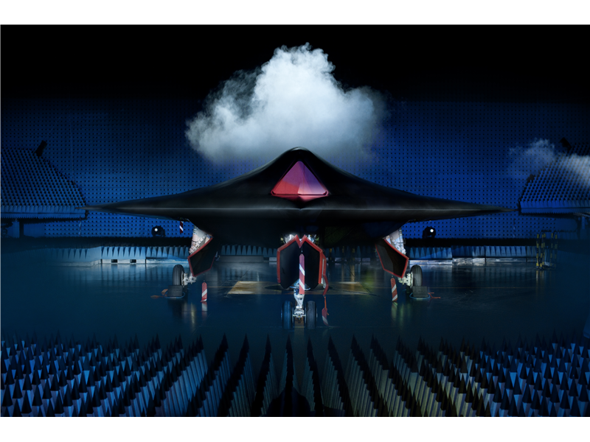

Slide 10
Lethal autonomous weapons systems
Weapon systems that can select and fire upon targets on their own, without any human intervention
NOT remotely piloted drones where humans select targets

Slide 11
Timeline
Nov 2012: US DoD Directive 3000.09 Autonomy in Weapons Systems
  “appropriate levels of human judgment”
April 2013: UN Heyns report proposes a treaty banning lethal autonomous weapons
April 2013: Launch of Campaign to Stop Killer Robots
April 2014-15: UN CCW meetings in Geneva
Jan 2015: AAAI Debate
July 2015: Open letter from the AI and robotics communities (14,000 signatories including 2,164 AI)

Slide 12
Are these things real?
Common misunderstanding: they require human-level AI so they are 20-30 years away
  “20 or 30 years away from being even possible”
    (techthefuture.com)
  “could be developed within 20 to 30 years”
    (20 Nobel peace prize laureates)
  “could become a reality within 20 or 30 years”
    (HRW)
On the other hand:
  “may come to fruition sooner than we realize”
    (Horowitz and Scharre, 2015)
  “probably feasible now”
    (UK MoD)

Slide 13
DARPA CODE program
Collaborative Operations in Denied Environments
Teams of autonomous aerial vehicles carrying out “all steps of a strike mission — find, fix, track, target, engage, assess”

Slide 14



Slide 15
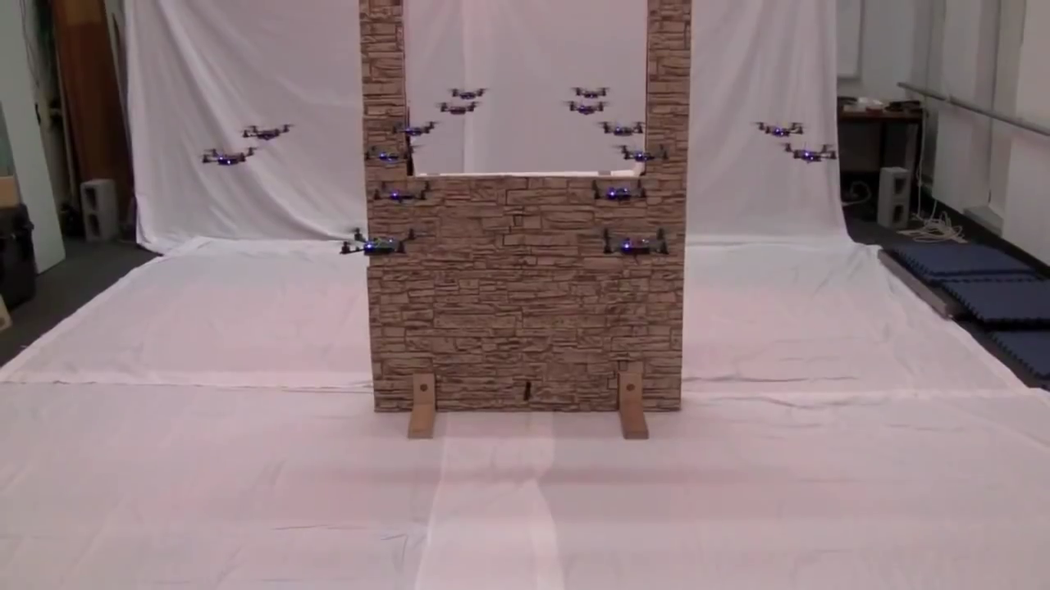

Slide 16
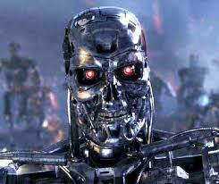

Physical limits
Systems will be constrained by physics (range, speed, acceleration, payload, stability, etc.), not by AI capabilities
E.g., lethality of very low-mass platforms is limited by physical robustness of humans:
  Could use very small caliber weapon
    Human eyeballs may be the easiest target
  Could use ~1g shaped charge on direct contact
1g HMTD, 9mm mild steel plate

Slide 17
What to do?
Sign the Open Letter
  tinyurl.com/awletter
Join the Campaign
  stopkillerrobots.org
If we fail, apologize
and buy bulletproof glasses

Slide 19
The end of jobs?
See Erik Brynjolfsson’s talk yesterday
These changes are driven by economic forces, not research policy
Major open question: what will people do, and what kind of economy will ensure gainful employment?

Slide 20
What to do?
Economists at Davos:
  Provide more unemployment insurance
Introduce economists to science fiction writers
Advocate for (or work on) better education systems
Develop technology that facilitates economic activity by individuals and small groups

Slide 22
The preamble
Eventually, AI systems will make better* decisions than humans
  Taking into account more information, looking further into the future
Have we thought enough about what that would mean?

Slide 23

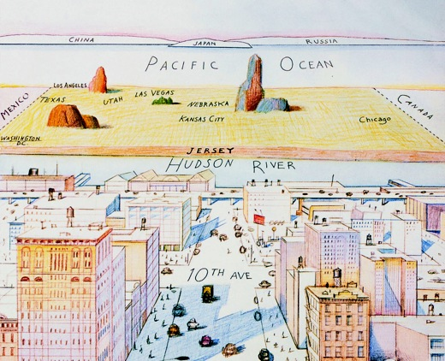

maximizing
expected
utility

Slide 24

Making better decisions

Slide 25
What if we succeed?
Success in creating AI would be the biggest event in human history
It’s important that it not be the last
Opening statement, People’s Republic of China; UN Meeting on Lethal Autonomous Weapons, Geneva, April 13, 2015

Slide 26
This needs serious thought
From: Superior Alien Civilization <sac12@sirius.canismajor.u>
To: humanity@UN.org
Subject: Contact
Be warned: we shall arrive in 30-50 years
From: humanity@UN.org
To: Superior Alien Civilization <sac12@sirius.canismajor.u>
Subject: Out of office: Re: Contact
Humanity is currently out of the office. We will respond to your message when we return.

Slide 27
Non-serious thoughts
Machines have an IQ
Machine IQ follows Moore’s Law
Malevolent armies of robots

Slide 28
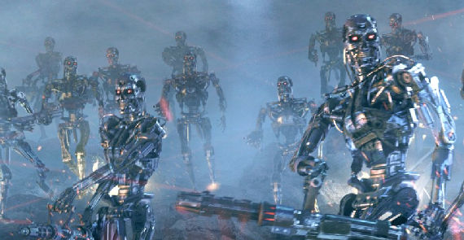

Slide 29
Non-serious thoughts
Machines have an IQ
Machine IQ follows Moore’s Law
Malevolent armies of robots
Spontaneous robot consciousness

Slide 31
Non-serious thoughts
Machines have an IQ
Machine IQ follows Moore’s Law
Malevolent armies of robots
Spontaneous robot consciousness
Any mention of AI in an article is a good excuse for….

Slide 33
What’s bad about better AI?
AI that is incredibly good at achieving something other than what we* really* want
AI, economics, statistics, operations research, control theory all assume utility to be exogenously specified

Slide 34

Value misalignment
E.g., “Calculate pi”, “Make paper clips”, “Cure cancer”
Cf. Sorcerer’s Apprentice, King Midas, genie’s three wishes

Slide 35
Value misalignment
If we use, to achieve our purposes, a mechanical agency with whose operation we cannot interfere effectively … we had better be quite sure that the purpose put into the machine is the purpose which we really desire
Norbert Wiener,
“Some Moral and Technical Consequences of Automation.”
Science, 1960

Slide 36
Instrumental goals
For any primary goal, the odds of success are improved by
  1) Maintaining one’s own existence
  2) Acquiring more resources
With value misalignment, these lead to obvious problems for humanity

Slide 37
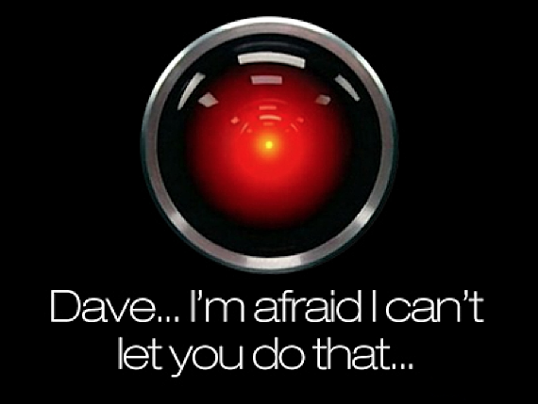
I’m sorry, Dave, I’m afraid I
can’t do that
Notes:
This is the problem of value alignment.
And when you mix that with a superintelligent system that can affect the world dramatically, it’s not such a good thing.
The point is that a machine can be better at making decisions
but still fail to make better decisions
if its values are not exactly the same as ours.

Slide 38
Proposal
Not just AI
Provably* beneficial* AI
Yes, but how?

Slide 39
Some ideas
Oracle AI: restrict the agent to answering questions correctly
Superintelligent verifiers: verify safety of superintelligent agents before deployment

Slide 40
Value alignment
Inverse reinforcement learning: learn a value function by observing another agent’s behavior
  Theorems already in place: probably approximately aligned learning

Slide 41

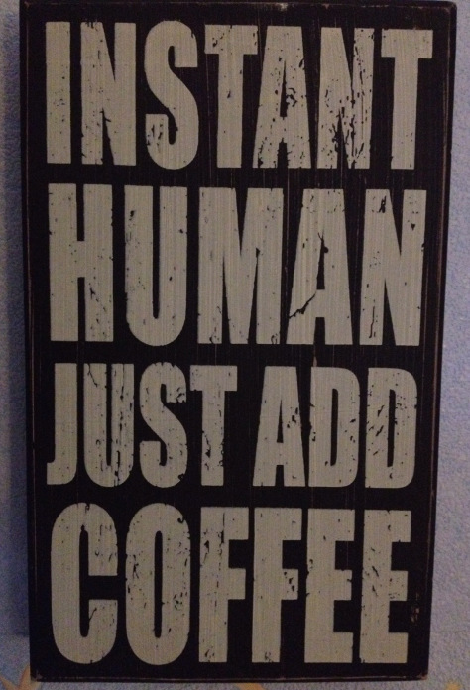
Notes:
One idea for doing this is called inverse reinforcement learning:
For example, the machine watches someone making coffee in the morning and learns the purpose, the utility function that underlies this behavior:
Namely, having coffee is a good idea (as long as it’s not too much!)

Slide 42
Value alignment
Cooperative IRL:
  Learn a multiagent value function whose Nash equilibria optimize the payoff for humans
  Broad Bayesian prior for human payoff
  Risk-averse agent + neutral bias => cautious exploration
  Potential loss (for humans) seems to depend on
    error in payoff estimate
    agent intelligence

Slide 43
Value alignment contd.
Obvious difficulties:
  Humans are irrational, inconsistent, weak-willed, computationally limited
  Values differ across individuals and cultures
  Individual behavior may reveal preferences that exist to optimize societal values

Slide 44
Reasons for optimism
Vast amounts of evidence for human behavior and human attitudes towards that behavior
We need value alignment even for subintelligent systems in human environments

Slide 45
Response 1:
It’ll never happen
or, “Yes, we may be driving towards a cliff, but I’m hoping we’ll run out of gas”
Notes:
OK, so we’re headed towards a cliff; but Im just hoping we run out of gas before we get there!

Slide 46
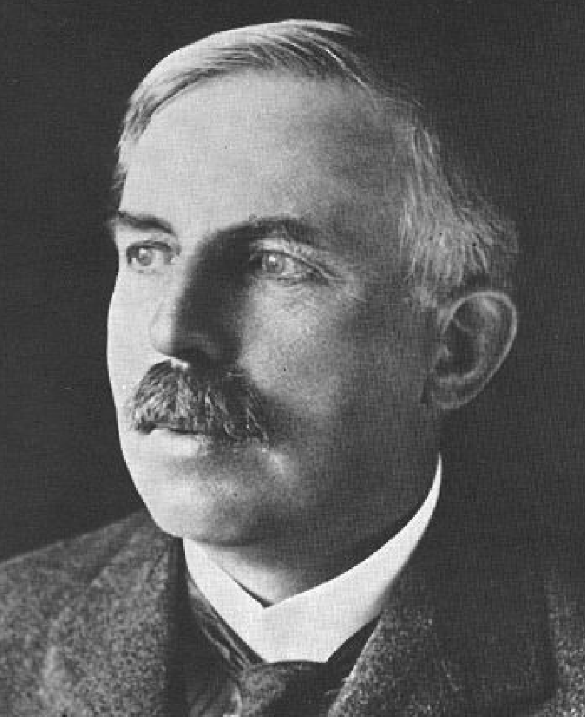
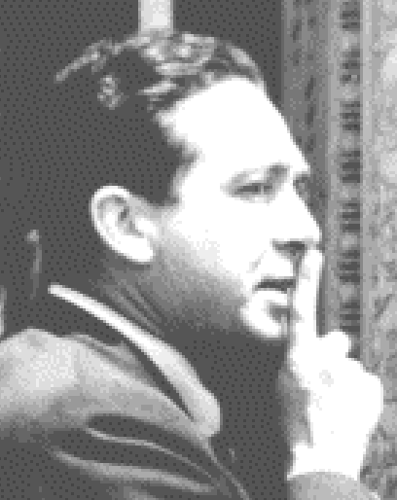
Response 1:
It’ll never happen
Sept 11, 1933: Lord Rutherford addressed BAAS: “Anyone who looks for a source of power in the transformation of the atoms is talking moonshine.”
Sept 12, 1933: Leo Szilard invented neutron-induced nuclear chain reaction
“We switched everything off and went home. That night, there was very little doubt in my mind that the world was headed for grief.”
Notes:
OK, so we’re headed towards a cliff; but Im just hoping we run out of gas before we get there!

Slide 47
Response 1b:
It’s too soon to worry about it
A large asteroid will hit the Earth in 75 years. When should we worry?

Slide 48
Response 1b:
It’s too soon to worry about it
“I don’t work on [it] for the same reason that I don’t work on combating overpopulation on the planet Mars” [[name omitted]]
OK, let’s continue this analogy:
  Major governments and corporations are spending billions of dollars to move all of humanity to Mars
  They haven’t thought about what we will eat and breathe when the plan succeeds

Slide 49
Response 1b:
It’s too soon to worry about it
If only we had worried about global warming in the late 19th C.

Slide 50
Response 2:
It’s never happened before …
“If you look at history you can find very few occasions when machines started killing millions of people.”
[[name omitted]], ICML 2015

Slide 51
Response 3:
You’re just anthropomorphizing
“survival instinct and desire to have access to resources … there’s no reason that machines will have that.”
[[name omitted]], ICML, 2015

Slide 52
Response 3b:
You’re just andromorphizing
“AI dystopias … project a parochial alpha-male psychology onto the concept of intelligence. … It’s telling that many of our techno-prophets can’t entertain the possibility that artificial intelligence will naturally develop along female lines.”
Steven Pinker, edge.org, 2014

Slide 53
Response 4:
You can’t control research
Asilomar Workshop (1975): self-imposed restrictions on recombinant DNA experiments
Industry adherence enforced by FDA ban on human germline modification
Pervasive* culture of risk analysis and awareness of societal consequences

Slide 54
Response 4b:
You’re just Luddites!!
The goal is not to stop AI research
The idea is to allow it to continue by ensuring that outcomes are beneficial
Solving this problem should be an intrinsic part of the field, just as containment is a part of fusion research
It isn’t “Ethics of AI”, it’s common sense!

Slide 55
Wiener, contd.
In this process [of science], 50 years are as a day in the life of an individual. …
The individual scientist must work as a part of a process whose timescale is so long that he himself can contemplate only a very limited sector of it. …

Slide 56
Wiener, contd.
For the individual scientist, [this] requires an imaginative forward glance at history which is difficult, exacting, and only partially achievable. …
We must always exert the full strength of our imagination to examine where the full use of our new modalities may lead us.

Slide 57
Summary
The AI community is moving with increasing speed towards the biggest event in human history
What to do? Expand the definition of the field!
  Pure intelligence is not enough

