Slide 1
Artificial Intelligence: Implications for Autonomous Weapons
Stuart Russell
University of California, Berkeley
Notes:
Mr. Chairman, distinguished colleagues, thank you for this opportunity to present some remarks. I’d like also to thank the entire CCW assembly for its wisdom in initiating these discussions before the fact. Let me also apologize for the relative lack of involvement of the technical community, with some notable exceptions.

Slide 2
Outline
AI and autonomy
State of the art
Likely future developments
Conclusions

Slide 3
What is AI?
The intelligent connection of perception to action
An AI system is intelligent to the extent that it does the right thing given the available information
The right thing = the action expected to achieve the goal (or maximize expected utility)
Notes:
There is no mystery here – it’s simply a matter of decision quality.

Slide 4


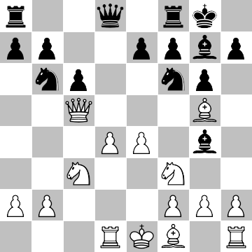
A chess robot: No autonomy
Take queen!
OK
boss

Slide 5
A chess robot: Some autonomy
take
queen
➔
➔
take
rook
take
queen
➔
move
king
really?
take
rook
➔
➔
take
queen
➔
move
king

Slide 6
A chess robot: Full autonomy
Win!

Slide 7
Locus of decision making
Even for chess, the human cannot provide, in advance, an individual response for each of 10⁵⁵ scenarios
Delegating to a machine results in different decisions from those the human would make
This is true regardless of whether it’s done by human-defined rules or purely autonomous deliberation

Slide 8

From chess to warfare

Slide 9
From chess to warfare
Many more agents and objects
Partial observability (‘fog of war”)
Continuous space and time
Uncertainty in action outcomes
Unknown unknownsTM
A theoretical framework is in place to support the development of precise definitions when necessary

Slide 10
AI: Rapidly increasing…
Computer power
Data resources
Industry research
Capabilities…

Slide 11
Perception
“Deep learning” achieves human-level object recognition on 1000 categories
  Note: “Combatant” is not a visual category!
Face recognition exceeds human performance
Vision and 3D sensors track moving objects in real time
Asynchronous video cameras ~1000fps support high-speed decision cycle

Slide 12
Navigation and mapping
Navigation is easy in known environments (e.g., cruise missiles)
Autonomous driving in complex urban environments is harder
Real-time robot exploration and 3D mapping of city/building/cave

Slide 13
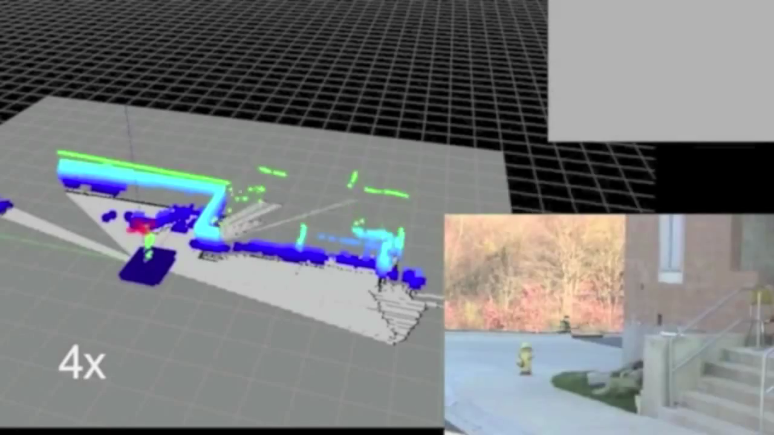

Slide 14
Motor control
Superhuman precision and dynamic control of aerobatic maneuvers, even in tight spaces
Stabilized platforms for automated snipers
Insect-sized flapping-wing vehicles
Robust legged locomotion

Slide 15
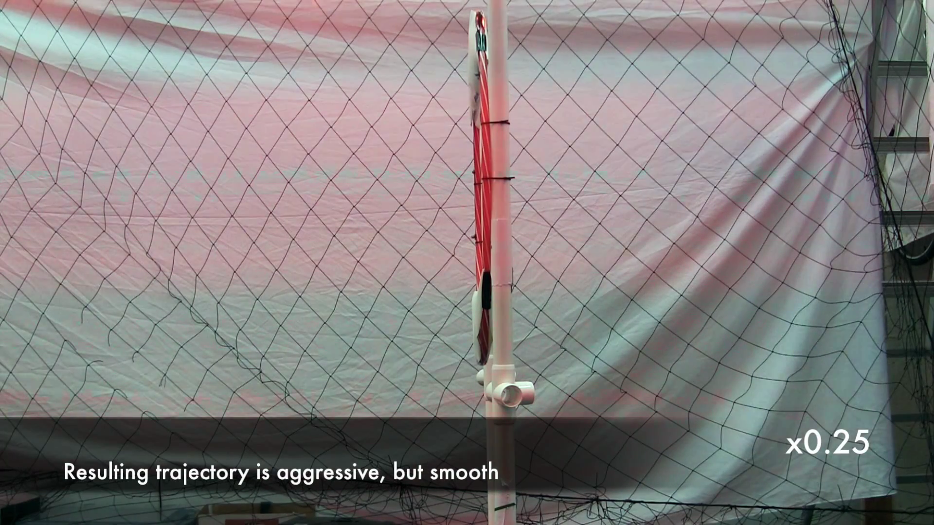

Slide 16
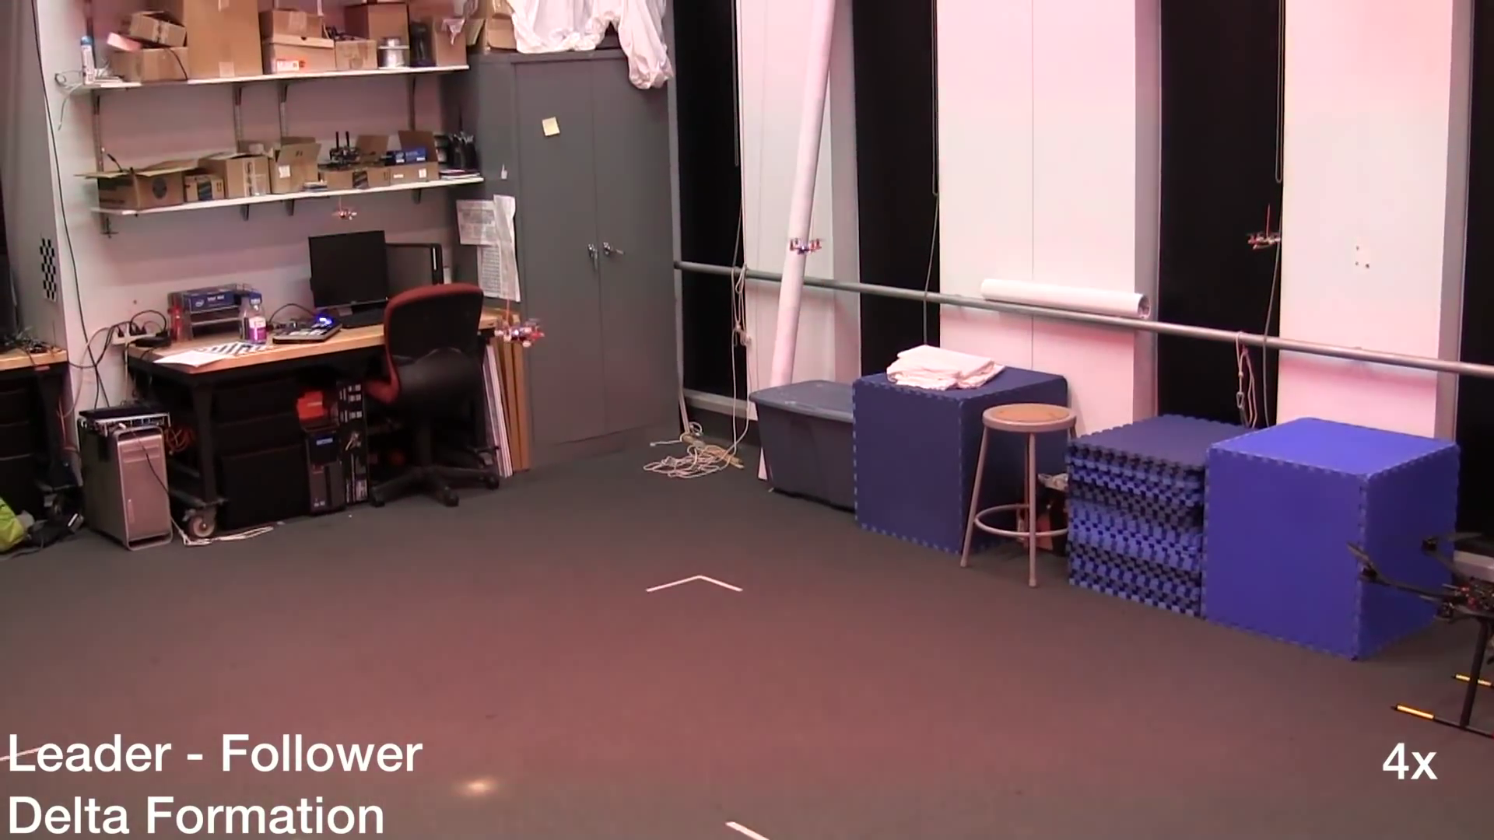

Slide 17
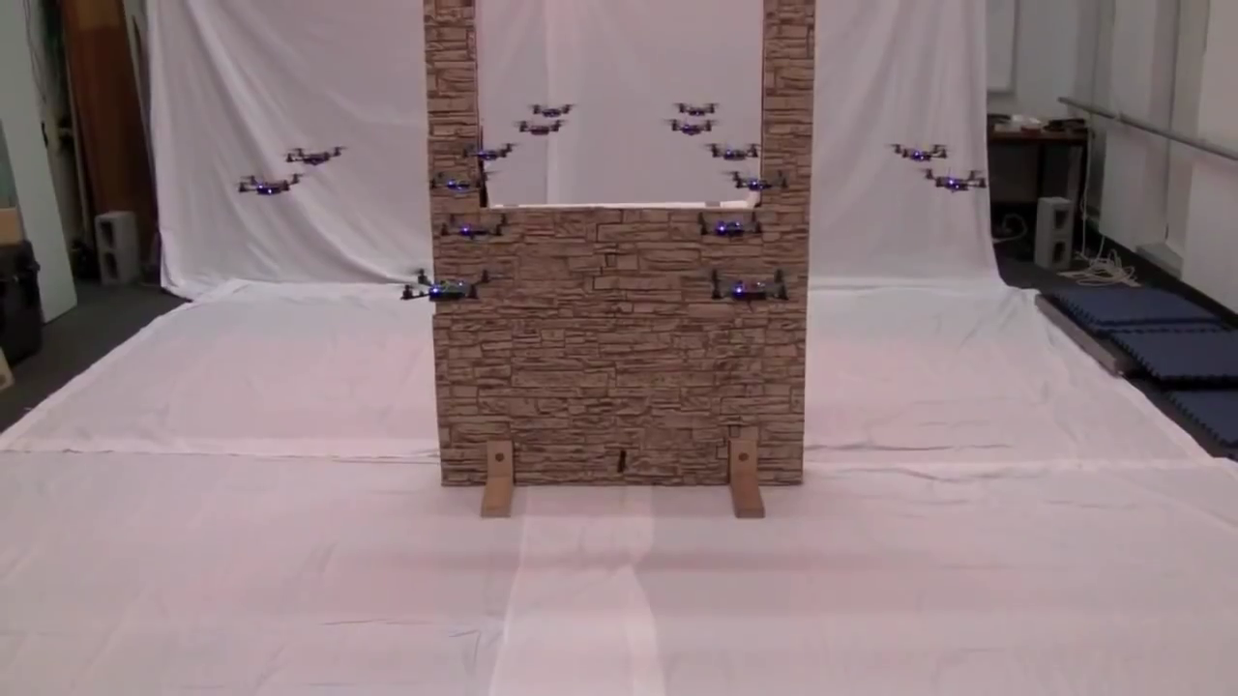

Slide 18
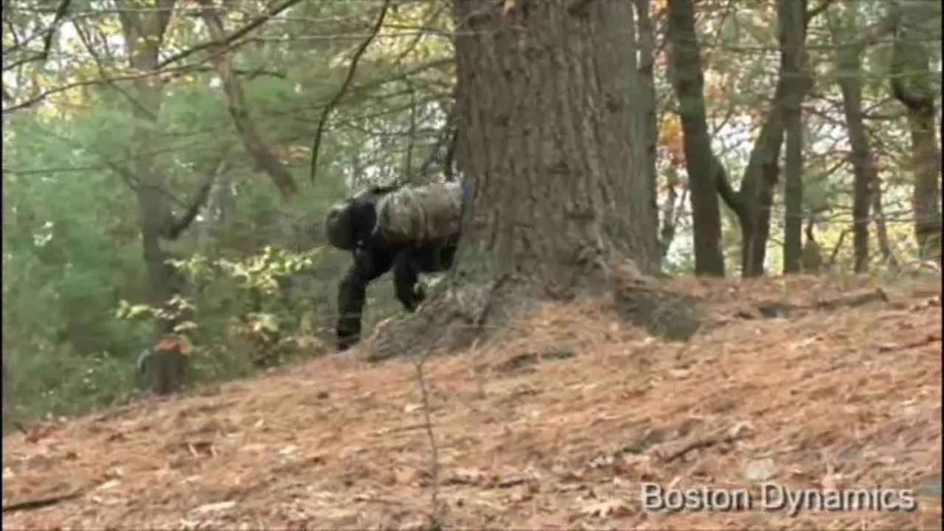

Slide 19
Tactical/strategic decisions
Tactical pursuit/targeting/attack: entirely self-taught superhuman performance on wide range of video games
Coordinated attack planning in strategy games, RoboCup soccer
Long-range hierarchical planning in strategy games, logistics, construction

Slide 20
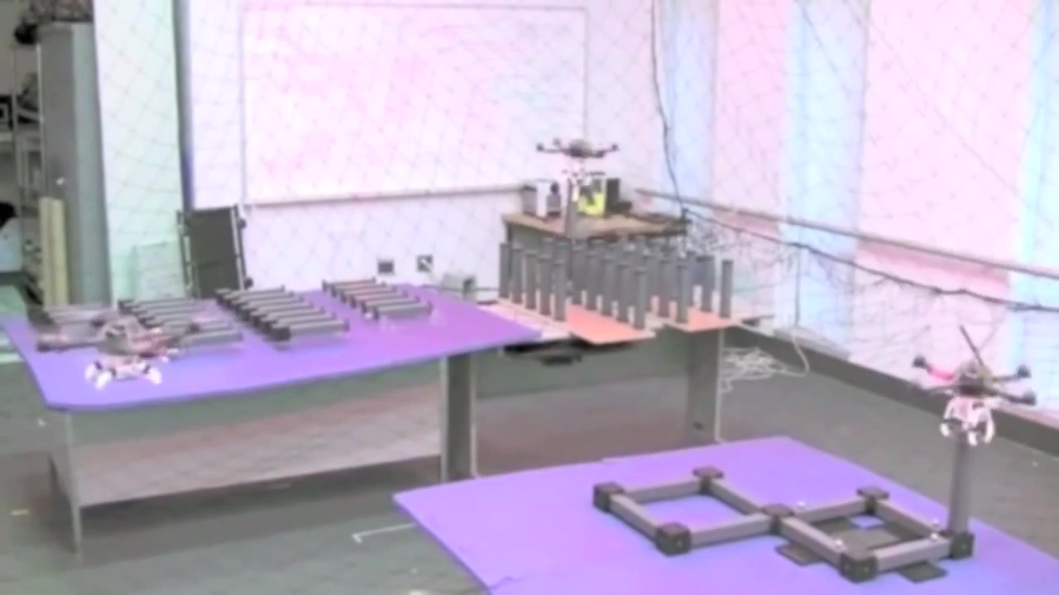

Slide 21
Future developments: Timeline
Received wisdom: 20-30 years away
  “20 or 30 years away from being even possible”
    (techthefuture.com)
  “could be developed within 20 to 30 years”
    (20 Nobel peace prize laureates)
  “could become a reality within 20 or 30 years”
    (HRW)
On the other hand:
  “may come to fruition sooner than we realize”
    (Horowitz and Scharre, 2015)
  “probably feasible now”
    (UK MoD)

Slide 22
Near-term capabilities
Distributed situation awareness
Integrated strategic, tactical planning and execution for extended tasks, e.g.,
    Clear an underground complex
    Prevent ground infiltration over large area
Sense/act decision cycles in milliseconds

Slide 23
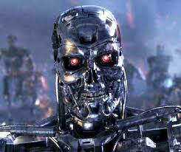

Physical limits
Systems will be constrained by physics (range, speed, acceleration, payload, stability, etc.), not by AI capabilities
E.g., lethality of very low-mass platforms is limited by physical robustness of humans:
  Could use very small caliber weapon
    Human eyeballs may be the easiest target
  Could use ~1g shaped charge on direct contact
1g HMTD, 9mm mild steel plate

Slide 24
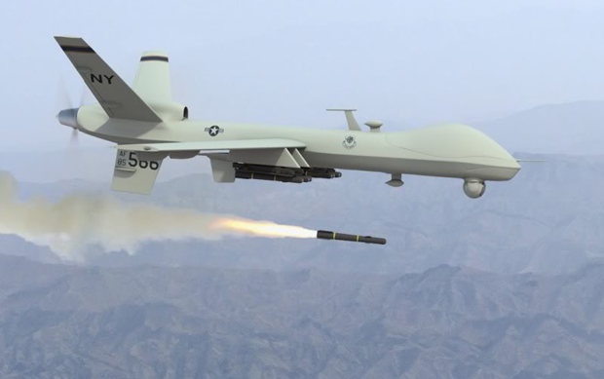
The IHL matchup: A false debate
versus

Slide 25
Instead….
What is the likely end point of an arms race, and is that desirable for the human race?
Given long-term concerns about controllability of human-level AI systems, should we arm them and turn over our defense to them?
What does a “Flash Crash” look like in the defense arena?

Slide 26
Conclusions
Sensory, computational, and power limitations are rapidly disappearing
Core AI capabilities (perception, navigation, mapping, tactics, strategic planning) are, or soon will be in place
LAWS will be limited by physics more than by AI
Humans will be largely defenseless
Non-state actors could use LAWS to significant effect
Controllability will be an increasingly difficult issue

Slide 27
Evolving Position of AI
Traditional AI position:
  “Cool toys, lots of funding!”
  “We take no position on ethical issues.”
Current AI position:
    “Cool toys, lots of funding!”
  Autonomous weapons may damage the reputation of AI
  Professional associations moving towards formal votes on official policy

